Slide 1
Asexual vs. Sexual Reproduction

Slide 2
Asexual Reproduction
By mitosis
Some unicellular organisms
Amoeba
Bacteria
Many plants
Offspring produced genetically identical to parent

Slide 3
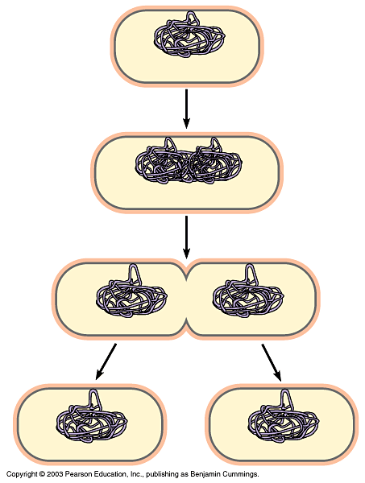
Binary Fission
Prokaryotic chromosome
Plasma membrane
Cell wall
Duplication of chromosome and separation of copies
Continued growth of the cell and movement of copies
Division into two cells

Slide 4
Sexual Reproduction
By meiosis
Potential for genetic variation

Slide 5
Genetic Variation
Number of possible chromosome combinations in gametes is 2^{n}
n – haploid number
2 – number of chromosomes in a homologous pair
n= 2
4 possible distributions
n=3
8 possible distributions
n=23
8,388,608 possible distributions
Before fertilization

Slide 6
Fertilization
Gametes fuse to form new diploid parent cell
Zygote
Each parent contributes one homolog to each homologous pair of chromosomes
Mitosis
Zygote grows in size
Becomes an embryo

Slide 7
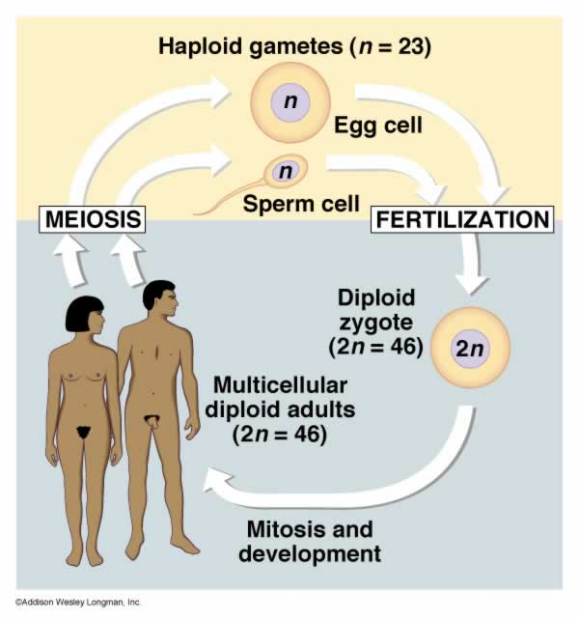

Slide 8
Stem Cells (embryonic or pluripotent)
Group of cells produced in early stages of the embryo’s growth
Similar to original zygote
Have the capability of becoming any type of cell
Genes within the cell can be turned off or turned on at specific time

Slide 9
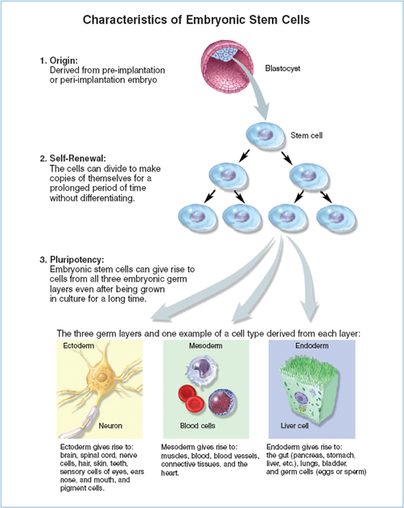

Slide 10
ADULT STEM CELLS
-undifferentiated cells found among differentiated cells in a tissue or organ that can renew itself and can differentiate to become some or all of the major cell types of that tissue or organ
-primary role is to maintain and repair the tissue where it is found

Slide 11
Cell Differentiation
Occurs by selective activation or inactivation of some of the genes
Cells become specialized
Later become tissues
Occurs when embryo reaches ~20-150 cells in size
Proteins are produced characteristic to its specific function

Slide 12
