Slide 1
Proteins

Slide 2
Proteins
Long linear chains of polypeptides
Polypeptide – chain of amino acids

Slide 3
Types of Proteins
Structural proteins
Regulatory proteins
Contractile proteins
Transport proteins
Storage proteins
Protective proteins
Membrane proteins
Toxins
Enzymes

Slide 4
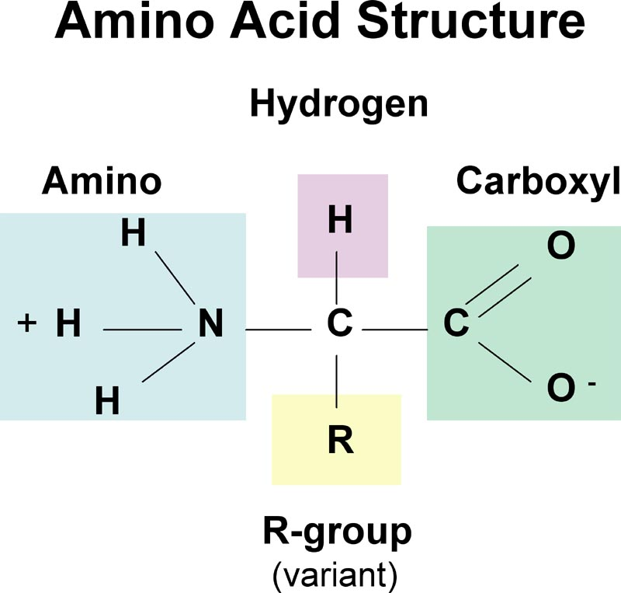
Amino Acids
20 amino acids
Combine to form every protein in body
Elements
Carbon
Hydrogen
Oxygen
Nitrogen

Slide 5
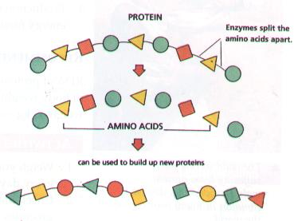
Making Proteins
Cannot make all amino acids
Eat protein in diet
Proteins broken down into amino acids in the digestive system
Amino acids used to build up proteins

Slide 6
Peptide Bond
Type of bond formed between two amino acids

Slide 7
Primary Structure
Linear order of amino acid chain
Sequence of amino acids
Glycine – Leucine – Glycine – Alanine - Lysine
Unique for each protein
Dictates the secondary and tertiary structures

Slide 8
Secondary Structure
Helices
Tightly wound coils
Pleated Sheets
Straight chains of aa held above or below in a parallel arrangement
Helices and Sheets add 3D structure to the overall protein

Slide 9
Tertiary Structure
Further bonding and interactions between amino acids
Gives the whole protein its overall 3D structure essential for function

Slide 10
Quaternary Structure
Some proteins are made up of more than one polypeptide chain
Form multi-subunit structures with other proteins in order to form one large protein

Slide 12
Denaturation
Change 3D shape
Break bonds
Causes of Denaturation:
pH changes
Temperature changes
Destroying protein shape disrupts function

Slide 13
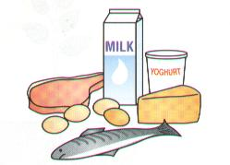
Sources of Proteins
High Biological Value
Animal foods
Meat
Fish
Eggs
Cheese
Milk
Low Biological Value
Plant foods
Peas
Beans
Whole cereals
Nuts
Contain fiber and are low in fat

Slide 14
Functions of Proteins
Growth of new cells
Repair of damaged cells
Production of heat and energy
Manufacture of enzymes, hormones and antibodies

Slide 15
Deficiency of Proteins
Slowed growth in children
Worn out cells are not replaced, prevents healing of wounds
Malfunction of organs due to hormone or enzyme deficiency
Susceptibility to disease, due to lack of antibodies

