Slide 1
Chapter 28 Nuclear Chemistry

Slide 2
Nuclear Chemistry-Uses

Slide 3
Nucleons
Protons: +1 each, determines identity of element, mass of 1 amu, determined using atomic number, nuclear charge
Neutrons: no charge, determines identity of isotope of an element, 1 amu, determined using mass number - atomic number (amu = atomic mass unit)
³²₁₆S and ³³₁₆S are both isotopes of S
S-32 has 16 protons and 16 neutrons
S-33 has 16 protons and 17 neutrons
All atoms of S have a nuclear charge of +16 due to the 16 protons.

Slide 4
Isotopes
Atoms of the same element MUST contain the same number of protons.
Atoms of the same element can vary in their numbers of neutrons, therefore many different atomic masses can exist for any one element. These are called isotopes.
The atomic mass on the Periodic Table is the weight-average atomic mass, taking into account the different isotope masses and their relative abundance.
Rounding off the atomic mass on the Periodic Table will tell you what the most common isotope of that element is.

Slide 5
Most Common Isotope
The weight-average atomic mass of Zinc is 65.39 amu. What is the most common isotope of Zinc? What are the most common isotopes of:
Co Ag
S Pb
FACT: one atomic mass unit (1.66 × 10⁻²⁷ kilograms) is defined as 1/12 of the mass of an atom of C-12.
This method doesn’t always work, but it usually does.
Zn-65!
Co-59
Ag-108
S-32
Pb-207

Slide 6
Natural Radioactivity
Natural decay starts with a parent nuclide that ejects a decay particle to form a daughter nuclide which is more stable than the parent nuclide was.

Slide 7
Stable Nuclei
The shaded region in the figure shows what nuclides would be stable, the so-called belt of stability.
There are no stable nuclei with an atomic number greater than 83. These nuclei tend to decay by alpha emission.

Slide 8
Neutron-Proton Ratios
Any element with more than one proton (i.e., anything but hydrogen) will have repulsions between the protons in the nucleus.
A strong nuclear force helps keep the nucleus from flying apart.
Neutrons play a key role stabilizing the nucleus.
Therefore, the ratio of neutrons to protons is an important factor.

Slide 9
Neutron-Proton Ratios
For smaller nuclei (Z ≤ 20) stable nuclei have a neutron-to-proton ratio close to 1:1.

Slide 10
Neutron-Proton Ratios
As nuclei get larger, it takes a greater number of neutrons to stabilize the nucleus.

Slide 11
Alpha Decay
The nucleus ejects two protons and two neutrons. The atomic mass decreases by 4, the atomic number decreases by 2.
²³⁸₉₂U →
²³⁴₉₀Th + ⁴₂He

Slide 12
Beta Decay
A neutron decays into a proton and an electron. The electron is ejected from the nucleus as a beta particle. The atomic mass remains the same, but the atomic number increases by 1.
¹⁴₆C →
¹⁴₇N + ⁰₋₁e

Slide 13
Gamma Decay
The nucleus has energy levels just like electrons, but the involve a lot more energy. When the nucleus becomes more stable, a gamma ray may be released. This is a photon of high-energy light, and has no mass or charge. The atomic mass and number do not change with gamma. Gamma may occur by itself, or in conjunction with any other decay type.

Slide 14
Radioactive Series
Large radioactive nuclei cannot stabilize by undergoing only one nuclear transformation.
They undergo a series of decays until they form a stable nuclide (often a nuclide of lead).

Slide 15
Charges of Decay Particles
What is the charge for each particle? Positive? Negative or Neutral?
Alpha Particle: Positive Beta Particle: Negative Gamma Particle(Ray): Neutral

Slide 16
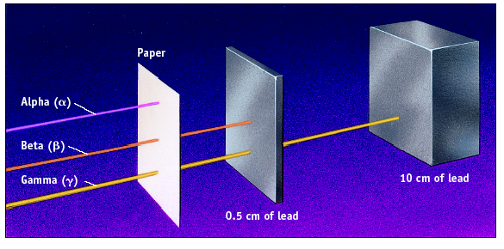
Penetrating Ability
Which has highest penetrating ability? Lowest?
Gamma
Alpha

Slide 17
Geiger Counter
Used to detect radioactive substances

Slide 18
Effects of Radiation
Dose depends on type of radioactivity, amount of radiation exposure and time of exposure.

Slide 19
Half-Life
Half life is the time it takes for half of the nuclei in a radioactive sample to undergo decay.
Problem Types:
Going forwards in time
Going backwards in time
Radioactive Dating

Slide 20
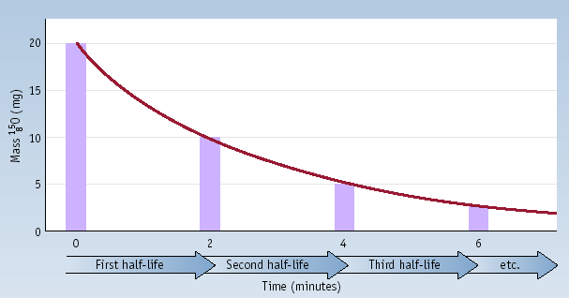
Half-Life
Decay of 20.0 mg of ¹⁵O. What remains after 3 half-lives? After 5 half-lives?
Approx 2.5 mg
Approx 0.625 mg

Slide 21
Going Forwards in Time
How many grams of a 10.0 gram sample of I-131 (half-life of T= 8 days) will remain in t = 24 days?
Calculate the number of half-lives(#HL)
#HL = t/T = 24/8 = 3
Cut 10.0g in half 3 times:
after 1 half-life: 5.00g, after 2 half-lives: 2.50g, after 3 half-lives: 1.25g

Slide 22
Going Backwards in Time
How many grams of a 10.0 gram sample of I-131 (half-life of 8 days) would there have been 24 days ago?
#HL = t/T = 24/8 = 3
Double 10.0g 3 times: before 1 half life: 20.0g, before 2 half-lives: 40.0g, before 3 half-lives: 80.0 g

Slide 23
Radiocarbon Dating
Radioactive C-14 is formed in the upper atmosphere by nuclear reactions initiated by neutrons in cosmic radiation
¹⁴N + ¹_{o}n → ¹⁴C + ¹H
The C-14 is oxidized to CO₂, which circulates through the biosphere.
When a plant dies, the C-14 is not replenished.
But the C-14 continues to decay with t_{1/2} = 5730 years.
Activity of a sample can be used to date the sample.

Slide 24
Radioactive Dating
A sample of an ancient scroll contains 50% of the original steady-state concentration of C-14. How old is the scroll?
50% = 1 HL
1 HL X 5730 y/HL = 5730y

Slide 25
LAB

Slide 26
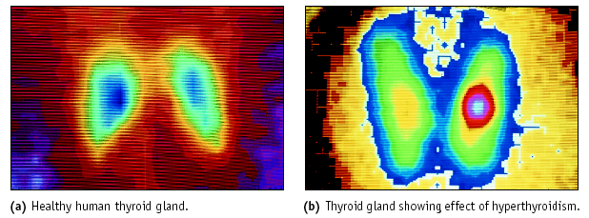
Nuclear Medicine: Imaging
Thyroid imaging using Tc-99 as a tracer

Slide 27
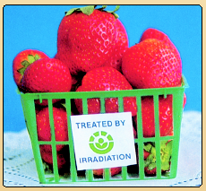
Food Irradiation
Food can be irradiated with γ rays from ⁶⁰Co or ¹³⁷Cs.
Irradiated milk has a shelf life of 3 mo. without refrigeration.
USDA has approved irradiation of meats and eggs.

Slide 28
Nuclear Power
Artificial Transmutation
Particle Accelerators
Nuclear Fission
Nuclear Fusion

Slide 29
Artificial Transmutation
¹₀n
⁴⁰₂₀Ca + _______ → ⁴⁰₁₉K + ¹₁H
⁹⁶₄₂Mo + ²₁H → ¹₀n + ________
Nuclide + Bullet → New Element + Fragment(s)
The masses and atomic numbers must add up to be the same on both sides of the arrow.
What substances are missing?
This is a neutron
⁹⁷₄₃Tc
This is Technetium

Slide 30
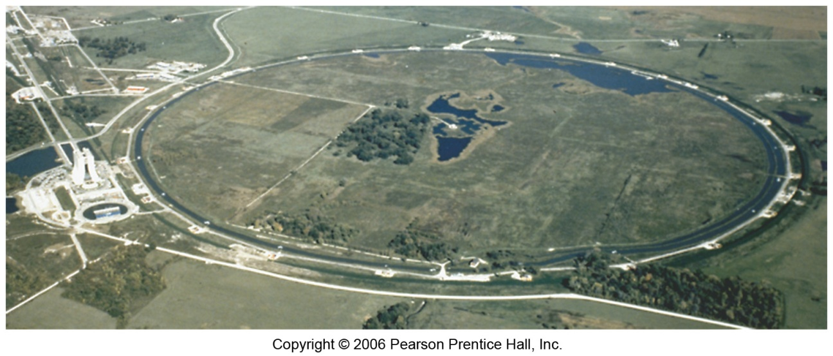
Particle Accelerators
Devices that use electromagnetic fields to accelerate particle “bullets” towards target nuclei to make artificial transmutation possible!
Most of the elements from 93 on up (the “transuranium” elements) were created using particle accelerators.
Particles with no charge cannot be accelerated by the charged fields.

Slide 31
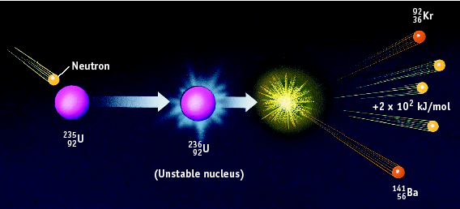
Nuclear Fission
²³⁵₉₂U + ¹₀n → ⁹²₃₆Kr + ¹⁴¹₅₆Ba + 3 ¹₀n + energy
The three neutrons given off can be reabsorbed by other U-235 nuclei to continue fission as a chain reaction
A tiny bit of mass is lost (mass defect) and converted into a huge amount of energy according to E=mc²

Slide 32
Chain Reaction Diagram

Slide 33
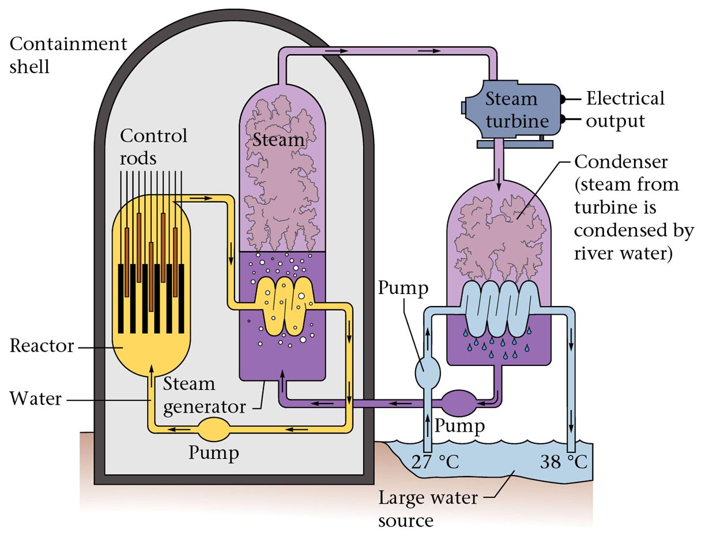
Diagram of a nuclear power plant

Slide 34
Nuclear Fusion
Energy
Fusion
small nuclei combine
²H + ³H ⁴He + ¹n +
1 1 2 0
Occurs in the sun and other stars. A small bit of mass is converted into a lot of energy!

Slide 35
Nuclear Fusion
Fusion
Excessive heat can not be contained
Attempts at “cold” fusion have FAILED.
“Hot” fusion is difficult to contain and is found in the sun

Slide 36
THE END

