Slide 1
Modes of Inheritance

Slide 2
Sex Linked Traits
Sex Chromosomes
Chromosomes responsible ________________ ______________________________________
Carry genes responsible for sex determination and other traits
______________________________________
X or Y chromosome
XX= ________________, XY= ______________

Slide 3
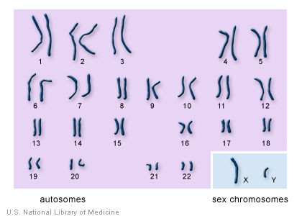
Karyotype

Slide 4
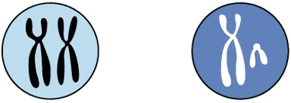
Sex Determination
eggs
sperm
X
Y
X
X
Female germ cell
Male germ cell
X
X
X
XX
XX
Y
XY
XY
sex chromosome combinations possible in new individual

Slide 5
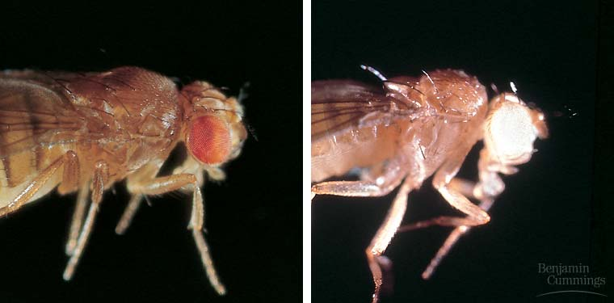
Sex Linked Traits
____________________________ are sex-linked
In many organisms, the __________________________ ______________________________________________
_______________________ is a sex-linked characteristic

Slide 6
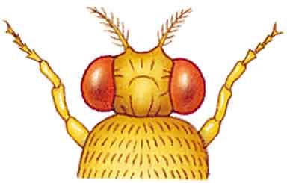
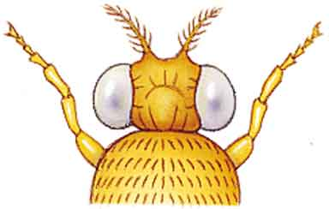
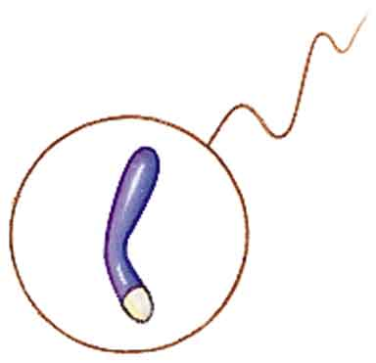
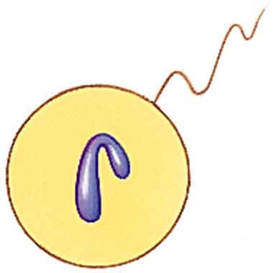
Discovering Linkage
One cross
homozygous
dominant
female
recessive
male
x
Gametes:
X
X
X
Y
heterozygous
female
heterozygous
male
All F₁ offspring have red eyes

Slide 7
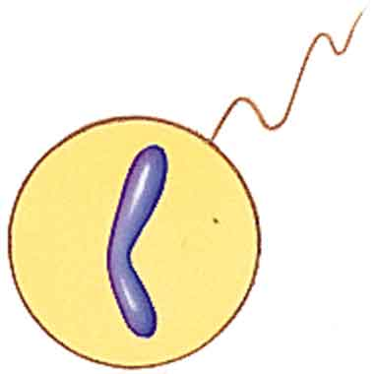
Discovering Linkage
homozygous
recessive
female
dominant
male
x
Gametes:
X
X
X
Y
heterozygous
females
recessive
males
F₁ offspring
Half are red-eyed females, half are white-eyed males

Slide 8
Sex Linked Disorders
Most sex-linked human disorders are ________
_________________________________________
_________________________
___________________________
Mostly seen in males
Why?? ______________________________
______________________________________
______________________________________

Slide 9
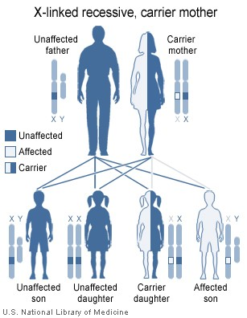
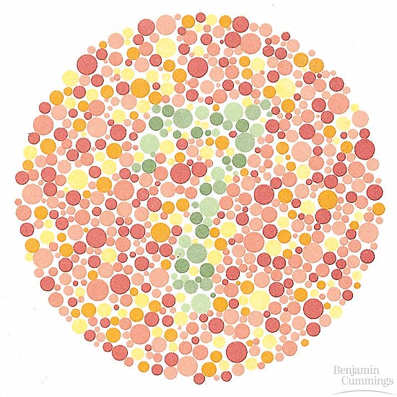
Color Blindness

Slide 10
Color Blindness
Inability ______________________________________________ _____________________________________
__________________________ in eyes called cones do not process light correctly
Interpret colors differently
Most common type is ___________________________________

Slide 11
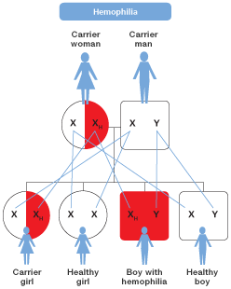
Hemophilia
_______________________ _________________________
Faulty enzyme

Slide 12
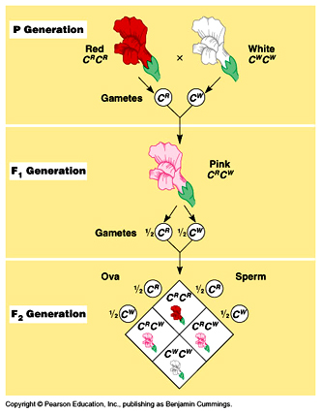
Incomplete Dominance
One trait is ____________________ ______________________________ ______________________________
Blending of two traits
Use capital letters with a prime ____ ______________________________ ______________________________
Ex. RR′ = pink

Slide 13
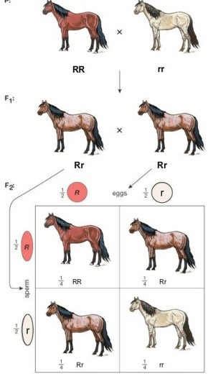
Co-Dominance
Both alleles are ______________ ___________________________
_____________________ of both traits is seen
Use _______________________ ___________________________ to represent the two traits
Ex. RW

Slide 14
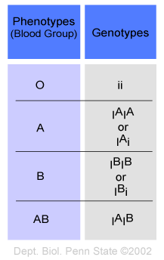
Multiple Alleles
Traits ____________________ _________________________
Ex. Blood type

Slide 15
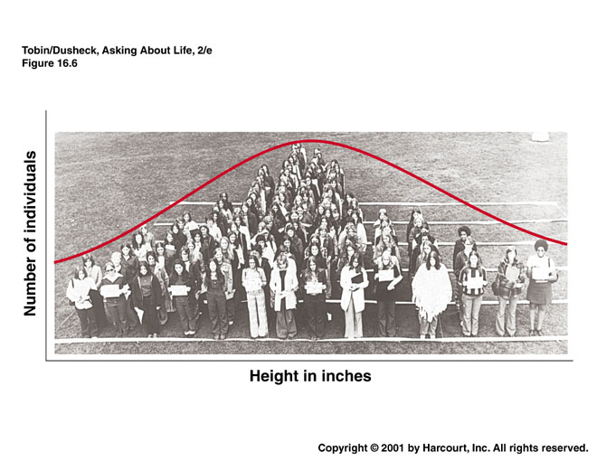
Polygenic Traits
Result of interaction of multiple genes

Slide 16
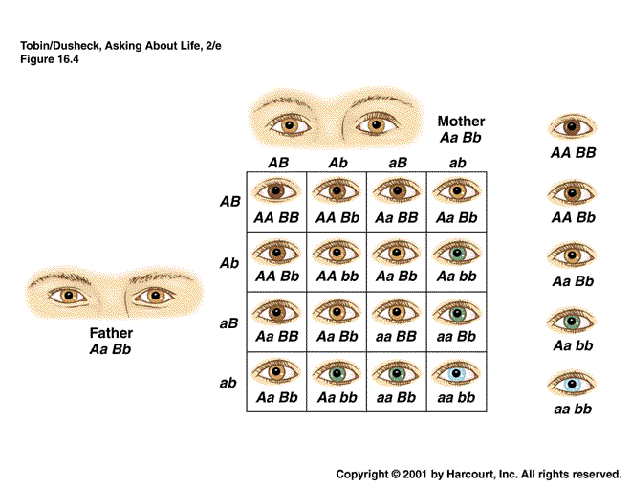
Eye Color

