Slide 1
Lipids

Slide 2
Lipids
Fats
Structure
Chains of methyl (-CH) units
Nonpolar
Do not dissolve in water

Slide 3
Fatty Acids
Lipids that store energy
3 fatty acids
Long chain of carbon atoms with hydrogen atoms bonded to them
Glycerol
Three carbons

Slide 4
Phospholipids
Make up the lipid bilayer of cell membranes

Slide 5
Waxes
Long-chain fatty acids
Firm consistency, repel water
Important in water-proofing

Slide 6
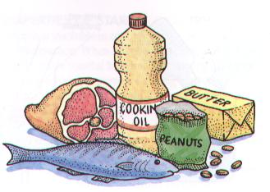
Saturated or Unsaturated

Slide 7
Saturated Fatty Acids
Unsaturated Fatty Acids
No double bonds
Solid at room temperature
Come mainly from animal sources
Meat
Eggs
Milk
Dairy products
Double bond prevents fat molecules from packing closely together
Tend to be liquid at room temperatures
Come mainly from plant and fish sources
Peas
Beans
Whole cereals
Nuts
Cooking oil
Oily fish

Slide 8
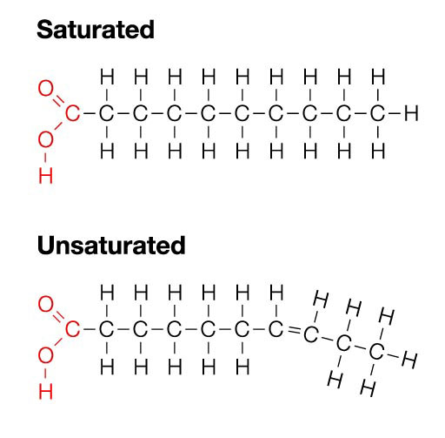

Slide 9
Cutting Down on Saturated Fats
Grill rather than fry
Use vegetable oil instead of hard fats for frying
Remove visible fat from meat
Use low fat milk, cheese, yogurt and mayonnaise

Slide 10
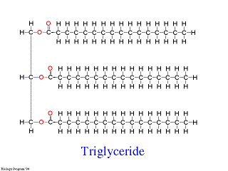
Trigylcerides
Saturated Fat
3 carbon chains
Linked to heart disease

Slide 11
Steroids
Cholesterol
Found in animal cell membranes
Sex hormones estrogen and testosterone
Able to pass through lipid bilayer of cell membranes
Affect the DNA in the cells

Slide 12
Functions of Lipids
Insulates the body
Provides the body with heat and energy
Energy storage
Membrane formation
Protective coverings
Vitamins and hormones

