Slide 1
CELLS

Slide 2
Cell
Structural and functional unit of all organisms
Some cells operate independently to carry out all of life’s processes, such as a single celled protist
Some cells function using many small structures called organelles

Slide 3
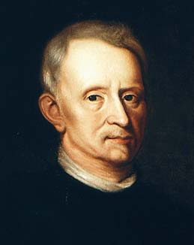
Robert Hooke

Slide 4
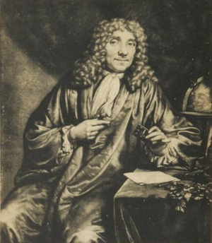
Anton van Leewenhoek

Slide 5
Discovery of Cells
Robert Hooke
Observed cork underneath a microscope
Saw a lot of tiny boxes
Called them cells
Anton van Leewenhoek
Used microscope to view water from a pond
Discovered many living one-celled organisms

Slide 6
Organelles
Means “Little Organs”
Small, specialized structures that have their own membranes
They perform many functions such as:
Help cell to move molecules
Create and store energy
Create proteins

Slide 7
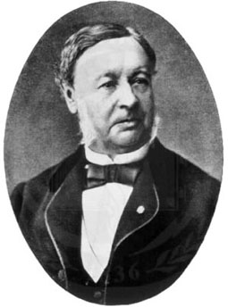
Theodor Schwann
Contributed to the Cell Theory:
Said that all animals are made of cells

Slide 8
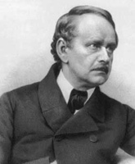
Matthias Schleiden
Contributed to Cell Theory:
Said all plants are made of cells.

Slide 9
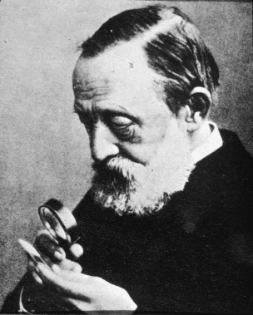
Rudolf Virchow
Contributed to Cell Theory:
Said all cells come from preexisting cells.

Slide 10
Cell Theory
Cells are the basic unit of all living things
All living things are made of cells
All cells come from other living cells of the same kind

Slide 11
Basic Cell Structure
All cells have:
Cell Membrane
Thin flexible boundary surrounding the cell
Cytoplasm
Watery, jelly-like part of the cell that contains salts, minerals, and cell organelles
Genetic Material
Area of the cell where the DNA (deoxyribonucleic acid) is stored
Regulates all cellular activities

Slide 12
Basic Types of Cells
Prokaryotic
Pro – before
Karyotic – nucleus
Cell does not have a true nucleus
Have no membrane bound organelles
Ex. Bacteria
Eukaryotic
Nucleus surrounded by a nuclear membrane
Membrane bound organelles
Tend to be larger than prokaryotic cells
Ex. Plant, animal, fungi, protist cells

Slide 13
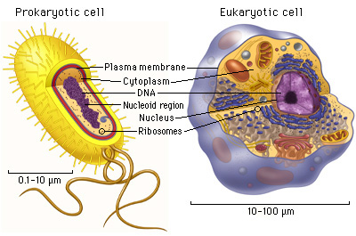
Prokaryotic vs. Eukaryotic Cells

Slide 14
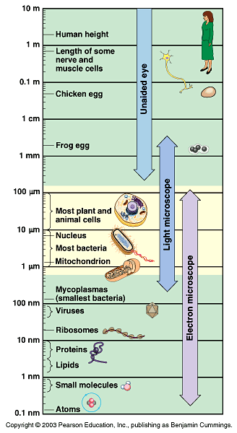
Cell Size
Cell size and shape relate to function
Cells are tiny
On average, there are100 trillion cells in the human body

Slide 15
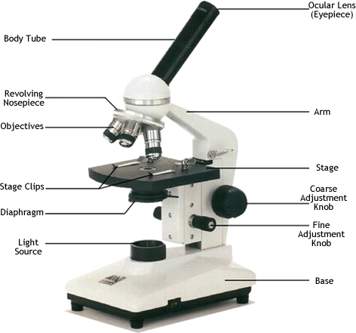
Parts of the Compound Light Microscope
Arm – attaches the body tube to the base
Base – supports all the parts of the microscope

Slide 16
Parts of the Compound Light Microscope
Eyepiece – where you place your eye to view the specimen
Body Tube – the tube that supports the eyepiece
Nosepiece – revolving device that holds the objectives
Objectives – lenses with varying magnifying powers

Slide 17
Parts of the Compound Light Microscope
Stage – the platform on which a slide is placed to view
Stage Clips – clips that hold a slide onto the stage

Slide 18
Parts of the Compound Light Microscope
Course Adjustment – knob used to focus a specimen under low power
Fine Adjustment – knob used to focus a specimen under high power

Slide 19
Parts of the Compound Light Microscope
Diaphragm – an opening under the stage that can be adjusted to allow different amounts of light to illuminate the specimen
Light Source – may be either a mirror or a light

Slide 20
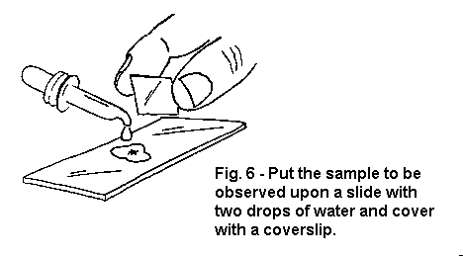
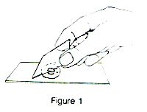
Preparing a Microscope Slide
Clean the slide and coverslip
Put the specimen on the slide
Sue an eyedropper to place one drop of water on the specimen
Place the coverslip at an angle next to the drop of water
Slowly lower the coverslip over the specimen without trapping air bubbles
Use a paper towel to remove any excess water from the slide
If the specimen needs to be stained, place a drop of stain next to the coverslip
Place a paper towel on the other side of the coverslip to draw the stain across the specimen

Slide 21
Handling the Microscope
Carry in upright position with one hand on arm and the other supporting the base

Slide 22
Care of Microscope
Use lens paper to clean lenses
Always focus on lowest power objective lens first
Use coarse adjustment knob only with lowest power
Oil should only be used with oil immersion lens

Slide 23
Storing the Microscope
Return slide to proper tray
Rotate objectives to lowest power
Wrap the cord around the base
Return microscope to shelf

