Slide 1
History of Life

Slide 2
Early History of Earth
Scientists suggest that:
The earth was very hot
Active volcanoes released gases to form early atmosphere
About 4.4 billion years ago, Earth cooled enough that water vapor condensed to cause millions of years of rainstorms, forming the oceans
Life originated in Earth’s oceans between 3.9 and 4.4 billion years ago

Slide 3
History in rocks
The earth is a dynamic system
The physical processes of Earth constantly destroy and form rocks
The oldest rocks found on Earth formed about 3.9 billion years ago

Slide 4
Fossils
Evidence of a once living organism
Used by paleontologists to study ancient life
Examples include trace fossils, casts, molds, petrified fossils, amber preserved fossils, frozen fossils

Slide 5
Fossil Formation
Organisms are buried in mud, sand or clay soon after death
Compression of particles over time forms sedimentary rock
Formed at low temps. And pressures so there is little damage to organism
Erosion later reveals fossil

Slide 6
Determining Fossil age
Relative dating
If rock layers remain undisturbed, the oldest are at the bottom and the youngest are on top
Using this principle, scientists determine relative age and the order of appearance of the species that are preserved as fossils in the layers
May use an index fossil---a fossil of known age---as a reference point

Slide 7
Determining Fossil age
Radiometric dating
Utilizes the radioactive isotopes in rocks and half-life to determine a specific age of a fossil
Used for igneous or metamorphic rocks associated with sedimentary rocks
Use carbon-14 to date fossils less than 50,000 years old

Slide 8
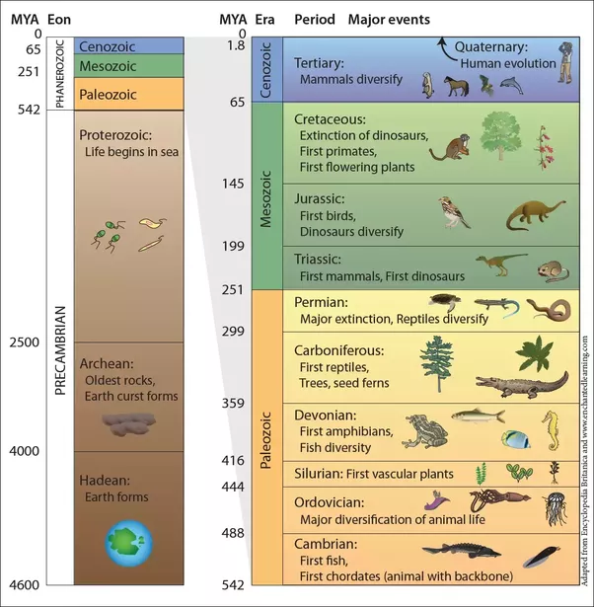
Geologic time
Geologic time scale
A chronology scientists
have developed based on evidence
from Earth’s rocks and fossils
The divisions in the scale are
distinguished by the organisms
that lived during that time
interval

Slide 9
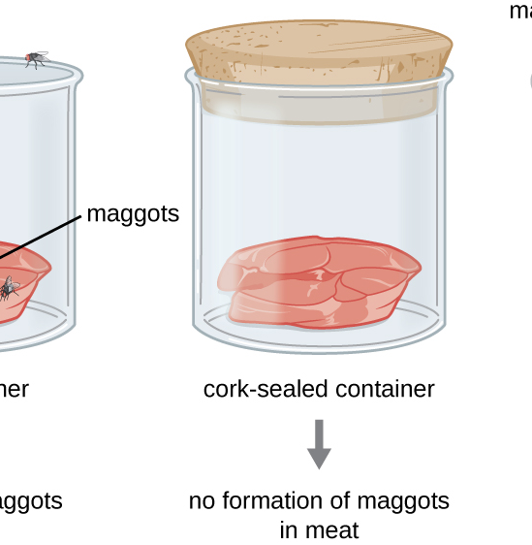
Origin of Life
Spontaneous generation
Early scientists thought life originated from nonliving material, as a vital life force existed in the air
1668; Francesco Redi performed
an experiment with raw meat in jars
Convinced many people that life did
not arise spontaneously
Invention of microscope and
abundance of microorganisms
left scientists unconvinced

Slide 10
Origin of Life

Slide 11
Origin of Life
Louis Pasteur
In the mid 1800’s disproved spontaneous generation
Use broth in swan necked flasks to prove biogenesis; living organisms only arise from other living organisms

Slide 12
Origin of Life

Slide 13
How Did life begin on earth?
Scientists hypothesize that two developments must have preceded the appearance of life on Earth
Simple organic molecules must have formed
Theses molecules must have become organized into complex organic molecules such as proteins

Slide 14
Oparin’s Hypothesis
Hypothesized that early Earth’s atmosphere probably contained water vapor, carbon dioxide, nitrogen, methane and ammonia, but no oxygen
Believed that life began in the oceans
Said energy from the sun, lightning and Earth’s heat triggered chemical reactions to produce small organic molecules
These molecules were washed into the oceans to form a “primordial soup”

Slide 15
Miller and Urey
In 1953, Stanley Miller and Harold Urey tested Oparin’s hypothesis in the lab
Mixed water vapor, ammonia, methane, hydrogen gas and electrical current
Allowed the results to cool and after 1 week found several kinds of amino acids, sugars and other organic molecules

Slide 16
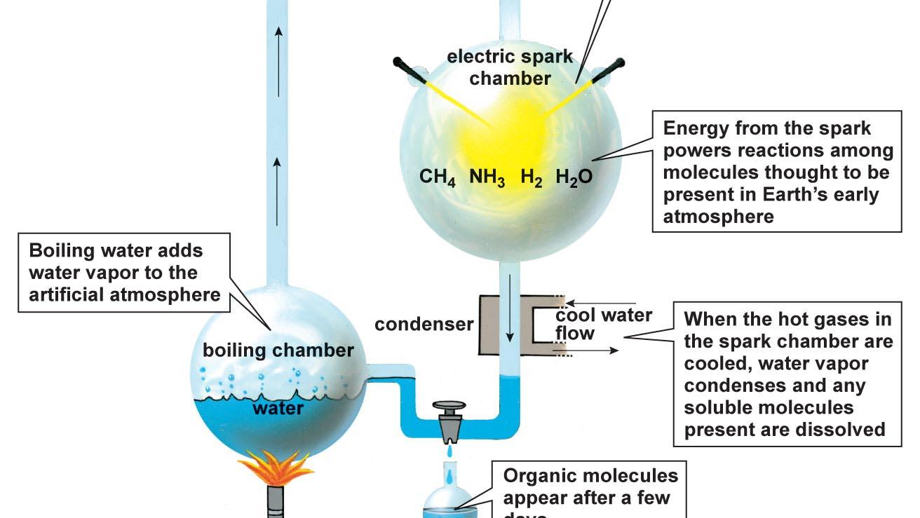

Slide 17
Evolution of Cells
1950’s; if amino acids are heated without oxygen they link to form complex proteins
1992; Sidney Fox
Heated solutions of amino acids produced protocells; large ordered structures enclosed by a membrane that could carry out some life activities, such as growth and division

Slide 18
Evolution of cells
Prokaryotic, unicellular, heterotrophic, anaerobic (similar to archaebacteria)
Prokaryotic, unicellular, anaerobic, photosynthetic (produced oxygen)
Prokaryotic, unicellular, aerobic, heterotrophic

Slide 19
Photosynthesizing prokaryotes
Production of oxygen affected Earth in two ways
Free oxygen allowed for the evolution of aerobic organisms
Buildup of oxygen created ozone layer to shield and protect organisms from Ultraviolet radiation and ultimately allowed for the development of eukaryotic organisms

Slide 20
Endosymbiont Theory
Lynn Margulis; 1960’s
Proposes that eukaryotes developed through a symbiotic relationship between ancient prokaryotes
Prokaryote ingests some aerobic bacteria; bacteria are protected and produce energy for prokaryote
Aerobes eventually become mitochondria
Prokaryotes also ingested photosynthetic bacteria
PS bacteria become chloroplasts

