Slide 1
Atomic Models Democritus to the Modern Model

Slide 2
Overview: Atomic Models Throughout History
Democritus (~400 BC)
Dalton (1800)
Thomson (1897)
Rutherford (1908)
Bohr (1913)
Wave Model-often called the “Electron-Cloud Model” or the Modern Model

Slide 3
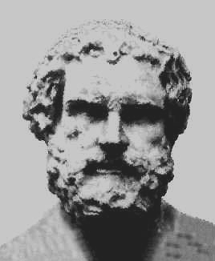
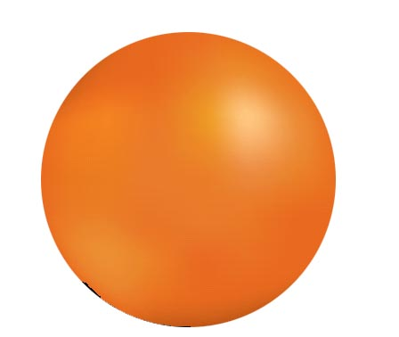
Democritus (~400 BC)
Said that atoms were indivisible and indestructible
Said the smallest piece of matter was an atom
Theory did not explain chemical behavior
Theory wasn’t accepted for 2100 years

Slide 4
Dalton (1800) (Dalton’s Atomic Theory)
All elements are composed of atoms. Atoms are indivisible and indestructible
Atoms of the same element are exactly alike
Atoms of different elements are different. Atoms of different elements can mix together
Compounds are formed by the joining of atoms of two or more elements

Slide 5
Dalton’s Symbols

Slide 6
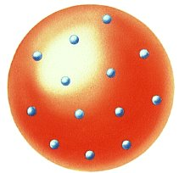
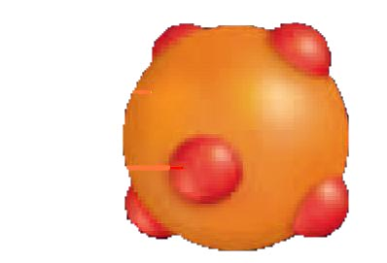
J. J. Thomson (1897) – Electrons
Discovered negatively charged particles(electrons) using a cathode ray tube where he passed electric current through gases at a low pressure.
The atom was divisible!
Particles discovered are electrons
Accurate ratio of mass to charge
Called the “Plum Pudding Model”
Atom consists of positively charged material with negative charges spread evenly throughout

Slide 7
Thomson’s Cathode Ray Tube - Electrons
Cathode Rays focused & accelerated by the (+) anode
The beam is attracted by the (+) deflecting coil and repelled by the (-) coil-bending it!
Thomson concluded that the beam must be made of (-) charged electrons and so the atom must have (-) charges in it!

Slide 8
Here’s JJ!
And here’s the plum pudding model.

Slide 9
Robert A. Millikan (1916)
Determined the quantity of charge carried by an electron.
Determined the ratio of the charge to the mass of an electron.
Calculated an accurate value for the mass of an electron.
Thus, an electron carries one unit of negative charge, and the mass is 1/1840 the mass of a H⁺

Slide 10
Rutherford (1908)-Nucleus
Gold Foil Experiment
Positive particles shot at gold foil occasionally bounced back!
The atom is mostly empty space
The atom has a dense, positively charged center called the nucleus
Most of the mass is in the nucleus

Slide 11
Rutherford’s Gold Foil Experiment
Observed Result
Most alpha particles passed through the gold foil. A few bounced back toward the source. He concluded that most of the atom was empty space with a dense, positively charged, center (nucleus).

Slide 12
Rutherford’s Atom
Dense (+) Nucleus with mostly empty space surrounding it.
Electrons are scattered in empty space, but take up almost nothing because they are so small.

Slide 13
James Chadwick - Neutron
Confirmed the existence of the neutron.
No charge
Mass approximately equal to the proton

Slide 14
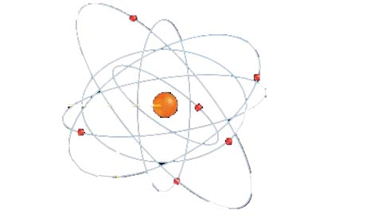
Bohr (1913) (Planetary Model)
Electrons move in definite orbits or “shells” around the nucleus
Places each electron in a specific energy level designated by n=1, n=2, n=3, etc

Slide 15
The Bohr Atom
The Bohr atom was able to explain why atoms seem to be related to energy.
As electrons jump from a higher to a lower energy level, they give off a photon of energy!
In order to jump to a higher energy level, they must absorb energy of just the right frequency

Slide 16
Wave Model (Quantum Model)
Definition of Quantum: a quantum of energy is the amount of energy required to move an electron from its present energy level to the next higher one.
Modern model based on wave mechanics
Nucleus is surrounded by electrons
Electrons do not move in orbits
We can determine the probable location of an electron based on the amount of energy the electron has
This probable location is called an orbital

Slide 17
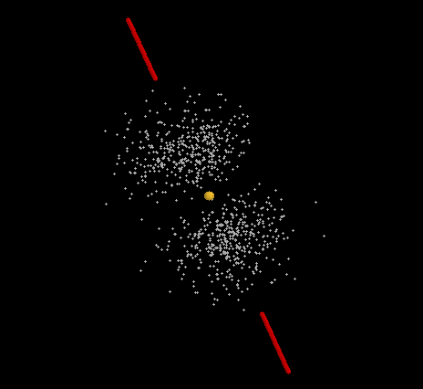
Some different views of the modern model
The electrons simply move too quickly to determine their exact location! They end up looking like the blurry blades of a moving fan!

