Slide 1
Chapter Intro-page 140
What You’ll Learn
You will relate an atom’s interactions with other atoms to its structure.
You will explain why water is important in life.
You will compare the role of biomolecules in organisms.

Slide 2
6.1 Section Objectives – page 141
Section Objectives:
Relate the structure of an atom to the identity of elements.
Relate the formation of covalent and ionic chemical bonds to the stability of atoms.

Slide 3
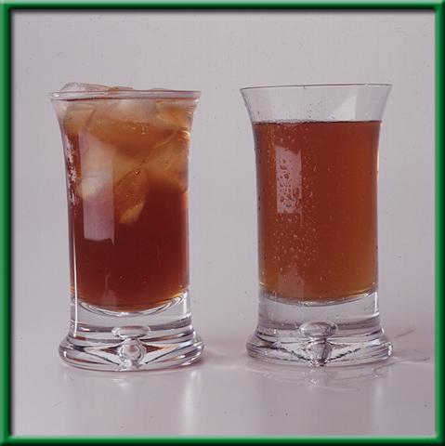
6.1 Section Objectives – page 141
Section Objectives:
Distinguish mixtures and solutions.
Define acids and bases and relate their importance to biological systems.

Slide 4
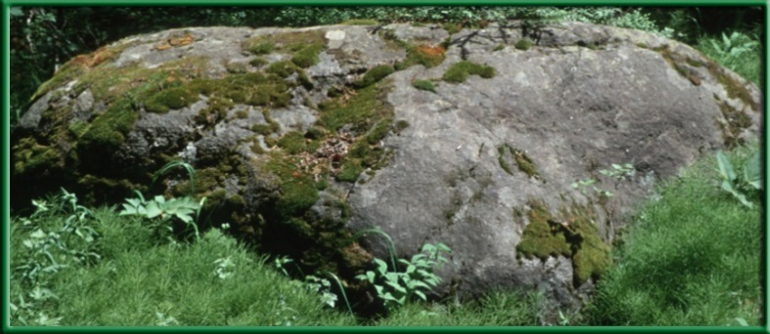
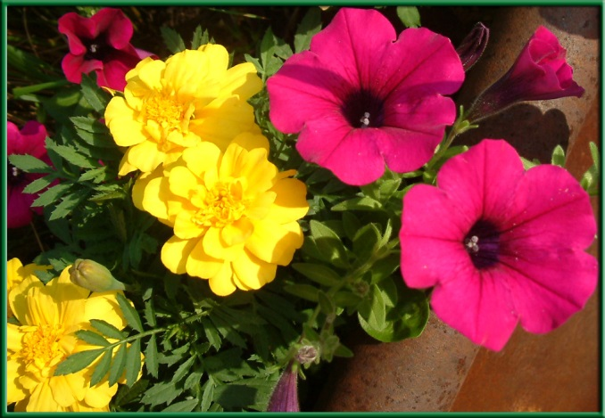
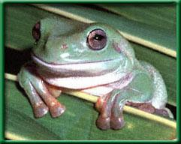
Section 6.1 Summary – pages 141-151
Elements
Everything – whether it is a rock, frog, or flower – is made of substances called elements.
An element is a substance that can’t be broken down into simpler chemical substances.

Slide 5
Section 6.1 Summary – pages 141-151
Natural elements in living things
Of the naturally occurring elements on Earth, only about 25 are essential to living organisms.
Carbon, hydrogen, oxygen, and nitrogen make up more that 96 percent of the mass of a human body.

Slide 6
Section 6.1 Summary – pages 141-151
Trace elements
Trace elements such as iron and copper, play a vital role in maintaining healthy cells in all organisms.
Plants obtain trace elements by absorbing them through their roots; animals get them from the foods they eat.

Slide 7
Section 6.1 Summary – pages 141-151
Table 6.1 Some Elements That Make Up the Human Body
Percent By Mass in Human Body
Percent By Mass in Human Body
Element
Symbol
Element
Symbol
Oxygen
O
65.0
Iron
Fe
trace
Carbon
C
18.5
Zinc
Zn
trace
Hydrogen
H
9.5
Copper
Cu
trace
Nitrogen
N
3.3
Iodine
I
trace
Calcium
Ca
1.5
Manganese
Mn
trace
Phosphorus
P
1.0
Boron
B
trace
Potassium
K
0.4
Chromium
Cr
trace
Sulfur
S
0.3
Molybdenum
Mo
trace
Sodium
Na
0.2
Cobalt
Co
trace
Chlorine
Cl
0.2
Selenium
Se
trace
Magnesium
Mg
0.1
Fluorine
F
trace

Slide 8
Section 6.1 Summary – pages 141-151
Atoms: The Building Blocks of Elements
An atom is the smallest particle of an element that has the characteristics of that element.
Atoms are the basic building blocks of all matter.

Slide 9
Section 6.1 Summary – pages 141-151
The structure of an atom
The center of an atom is called the nucleus
All nuclei contain positively charged particles called protons (p⁺).
Most contain particles that have no charge, called neutrons (n⁰).

Slide 10
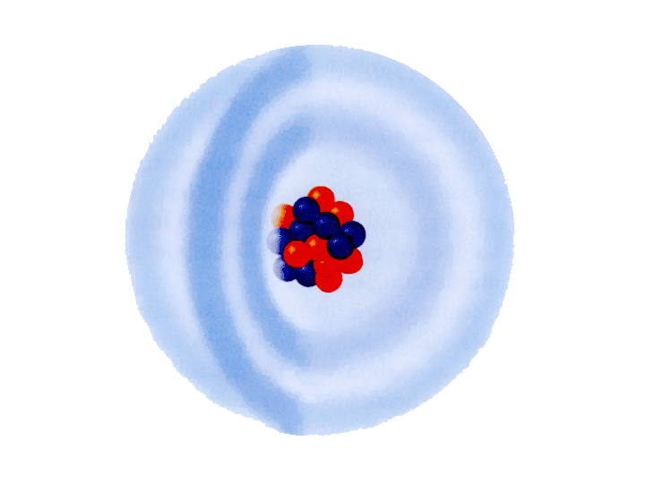
Section 6.1 Summary – pages 141-151
The Structure of an atom
The region of space surrounding the nucleus contains extremely small, negatively charged particles called electrons (e⁻)
This region of space is referred to as an electron cloud.
Nucleus
Electron energy levels

Slide 11
Section 6.1 Summary – pages 141-151
The Structure of an atom
Because opposites attract, the negatively charged electrons are held in the electron cloud by the positively charged nucleus.

Slide 12
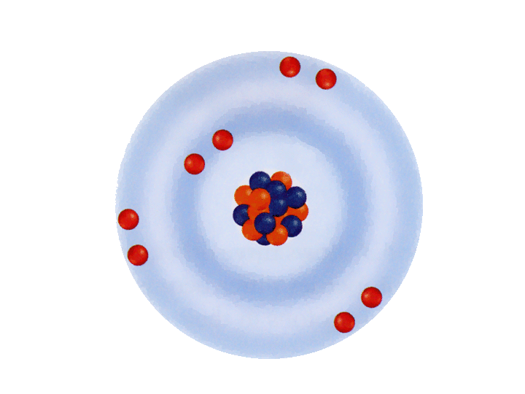
Section 6.1 Summary – pages 141-151
Nucleus
Electron energy levels
8 protons (p+)
8 neutrons (n⁰)
Electrons exist around the nucleus in regions known as energy levels.
Oxygen atom
The first energy level can hold only two electrons. The second level can hold a maximum of eight electrons. The third level can hold up to 18 electrons.

Slide 13
Section 6.1 Summary – pages 141-151
Electron energy levels
Atoms contain equal numbers of electrons and protons; therefore, they have no net charge.

Slide 14
Section 6.1 Summary – pages 141-151
Isotopes of an Element
Atoms of the same element always have the same number of protons but may contain different numbers of neutrons.
Atoms of the same element that have different numbers of neutrons are called isotopes of that element.

Slide 15
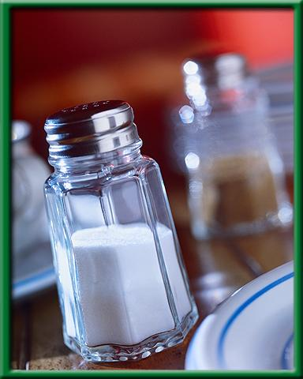
Section 6.1 Summary – pages 141-151
Compounds and Bonding
A compound is a substance that is composed of atoms of two or more different elements that are chemically combined.
Table salt (NaCl) is a compound composed of the elements sodium and chlorine.

Slide 16
Section 6.1 Summary – pages 141-151
How covalent bonds form:
Atoms combine with other atoms only when the resulting compound is more stable than the individual atoms.
For many elements, an atom becomes stable when its outermost energy level is full.
Sharing electrons with other atoms is one way for elements to become stable.

Slide 17
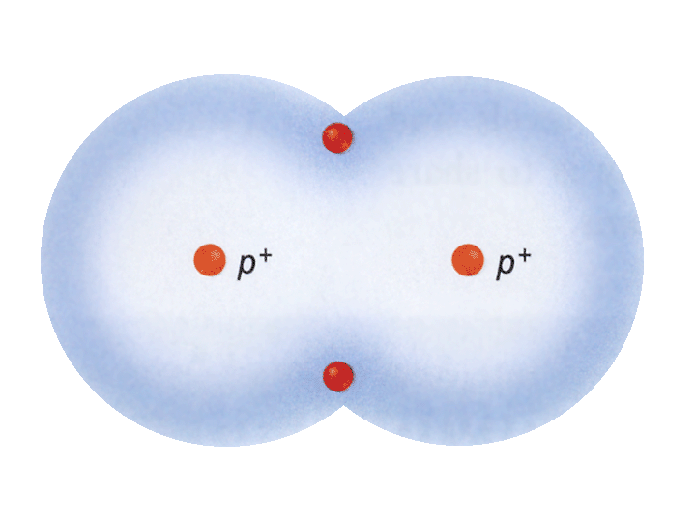
Section 6.1 Summary – pages 141-151
How covalent bonds form
Two hydrogen atoms can combine with each other by sharing their electrons, so each atom becomes stable.
Hydrogen molecule

Slide 18
Section 6.1 Summary – pages 141-151
How covalent bonds form
The attraction of the positively charged nuclei for the shared, negatively charged electrons holds the atoms together.
Hydrogen molecule

Slide 19
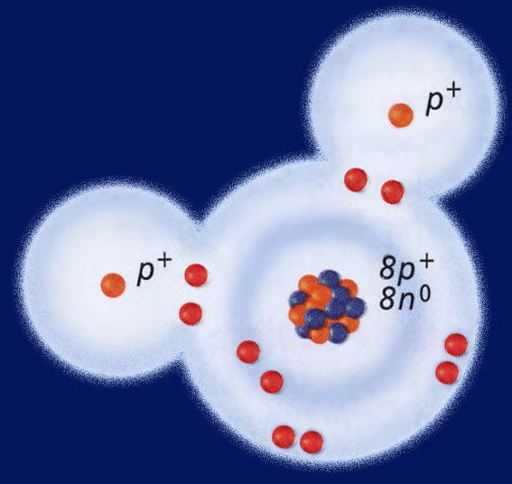
Section 6.1 Summary – pages 141-151
How covalent bonds form:
A covalent bond occurs when electrons are shared.
A molecule is a group of atoms held together by covalent bonds. It has no overall charge.
Water molecule

Slide 20
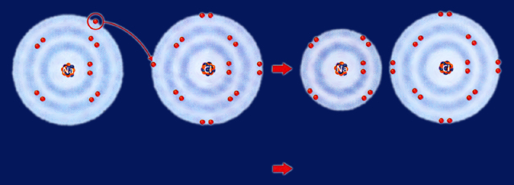
Section 6.1 Summary – pages 141-151
How ionic bonds form:
An atom (or group of atoms) that gains or loses electrons has an electrical charge is called an ion. An ion is a charged particle made of atoms.
The attractive force between two ions of opposite charge is known as an ionic bond.

Slide 21
Section 6.1 Summary – pages 141-151
Chemical Reactions
Chemical reactions occur when bonds are formed or broken, causing substances to recombine into different substances.
Ionic bond
+
Na⁺ ion: 11p⁺
Na atom: 11p⁺
Cl atom: 17p⁺
10e ―
Cl― ion: 17p⁺
11e ―
17e ―
18e ―
Sodium atom
+
Chlorine atom
Sodium⁺ Ion
+
Chlorine― ion

Slide 22
Section 6.1 Summary – pages 141-151
Chemical Reactions
All of the chemical reactions that occur within an organism are referred to as that organism’s metabolism.
A shorthand way of showing a chemical reaction is called a chemical equation.

Slide 23
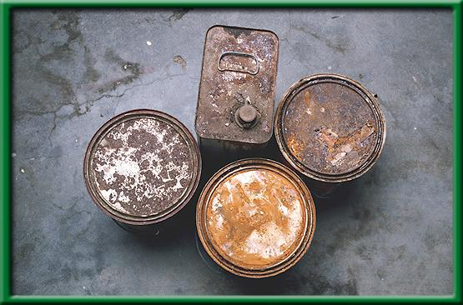
Section 6.1 Summary – pages 141-151
Writing chemical equations
In a chemical reaction, substances that undergo chemical reactions are called reactants.
Substances formed by chemical reactions are called products.
The compounds involved are shown by writing chemical formulas.

Slide 24
Section 6.1 Summary – pages 141-151
Writing chemical equations
For example, a molecule of table sugar can be represented by the formula: C₁₂H₂₂O₁₁.
The Law of Conservation of Matter states that atoms are neither created nor destroyed in chemical reactions. The atoms are simply rearranged.

Slide 25
Section 6.1 Summary – pages 141-151
Mixtures and Solutions
A mixture is a combination of substances in which the individual components retain their own properties, as no bonds are formed or broken.
Neither component of the mixture changes.

Slide 26
Section 6.1 Summary – pages 141-151
Mixtures and Solutions
A solution is a mixture in which one or more substances (solutes) are distributed evenly in another substance (solvent).
Sugar molecules in a powdered drink mix dissolve easily in water to form a solution.

Slide 27
Section 6.1 Summary – pages 141-151
Acids and bases
Chemical reactions can occur only when conditions are right.
A reaction may depend on:
- energy availability
- temperature
- concentration of a substance
- pH of the surrounding environment

Slide 28
Section 6.1 Summary – pages 141-151
Acids and bases
The pH is a measure of how acidic or basic a solution is.
A scale with values ranging from 0 to 14 is used to measure pH.
More acidic
Neutral
More basic

Slide 29
Section 6.1 Summary – pages 141-151
Acids and bases
Substances with a pH below 7 are acidic. An acid is any substance that forms hydrogen ions (H⁺) in water.
A solution is neutral if its pH equals seven.
More acidic
Neutral
More basic

Slide 30
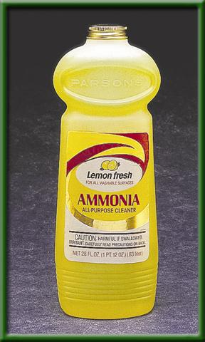
Section 6.1 Summary – pages 141-151
Acids and bases
Substances with a pH above 7 are basic. A base is any substance that forms hydroxide ions (OH⁻) in water.
pH 11

Slide 31
Section 2 Objectives – page 152
Section Objectives
Relate water’s unique features to polarity.
Identify how the process of diffusion occurs and why it is important to cells.

Slide 32
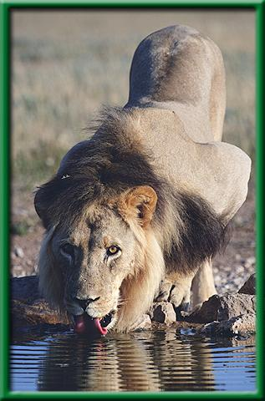
Summary Section 2 – pages 152-156
Water and Its Importance
Water is perhaps the most important compound in living organisms.
Water makes up 70 to 95 percent of most organisms.

Slide 33
Summary Section 2 – pages 152-156
Water is Polar
Sometimes, when atoms form covalent bonds they do not share the electrons equally. This is called a polar bond.

Slide 34
Summary Section 2 – pages 152-156
Water is Polar
A polar molecule is a molecule with an unequal distribution of charge; that is, each molecule has a positive end and a negative end.
Water is an example of a polar molecule.
Water can dissolve many ionic compounds, such as salt, and many other polar molecules, such as sugar.

Slide 35
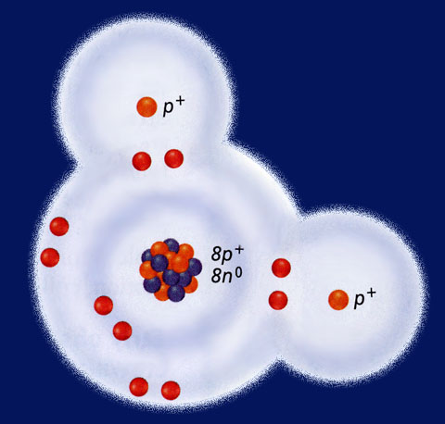
Summary Section 2 – pages 152-156
Water is Polar
Water molecules also attract other water molecules.
Hydrogen atom
Weak hydrogen bonds are formed between positively charged hydrogen atoms and negatively charged oxygen atoms.
Hydrogen atom
Oxygen atom

Slide 36
Summary Section 2 – pages 152-156
Water resists temperature changes
Water resists changes in temperature. Therefore, water requires more heat to increase its temperature than do most other common liquids.

Slide 37
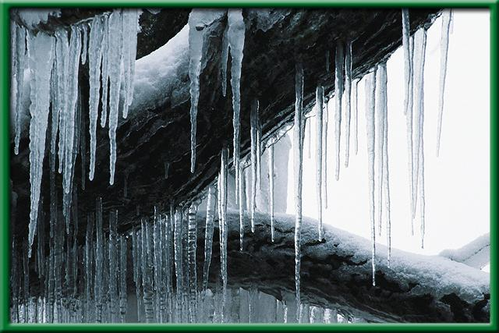
Summary Section 2 – pages 152-156
Water expands when it freezes
Water is one of the few substances that expands when it freezes.
Ice is less dense than liquid water so it floats as it forms in a body of water.

Slide 38
Chapter Summary – 6.1
Atoms and Their Interactions
Atoms are the basic building block of all matter.
Atoms consist of a nucleus containing protons and usually neutrons. The positively charged nucleus is surrounded by rapidly moving, negatively charged electrons.
Atoms become stable by bonding to other atoms through covalent or ionic bonds.

Slide 39
Chapter Summary – 6.1
Atoms and Their Interactions
Components of mixtures retain their properties.
Solutions are mixtures in which the components are evenly distributed.
Acids are substances that from hydrogen ions in water. Bases are substances that form hydroxide ions in water.

Slide 40
Chapter Summary – 6.2
Water and Diffusion
Water is the most abundant compound in living things.
Water is an excellent solvent due to the polar property of its molecules.
Particles of matter are in constant motion.
Diffusion occurs from areas of higher concentration to areas of lower concentration.

Slide 41
Chapter Summary – 6.3
Life Substances
All organic compounds contain carbon atoms.
There are four principal types of organic compounds, or biomolecules, that make up living things: carbohydrates, lipids, proteins, and nucleic acid.
The structure of a biomolecule will help determine its properties and functions.

Slide 42
Chapter Assessment
Question 1
What is the difference between a compound and an element?
Answer
A compound is a substance that is composed of atoms of two or more different elements that are chemically combined. An element is a substance that can't be broken down into simpler chemical substances.

Slide 43
Chapter Assessment
Question 2
What is it called when atoms share electrons?
Water molecule
A. covalent bonding
C. hydrogen bonding
B. ionic bonding
D. diffusion

Slide 44
Chapter Assessment
The answer is A. Covalent bonds differ from ionic bonds in that the shared electrons move about the nuclei of both atoms of the covalent compound.
Water molecule

Slide 45
Chapter Assessment
Question 3
Which of the following combinations will produce a solution?
A. chocolate chips and cookie dough
B. sand and sugar crystals
C. powdered drink mix and water
D. oil and vinegar

Slide 46
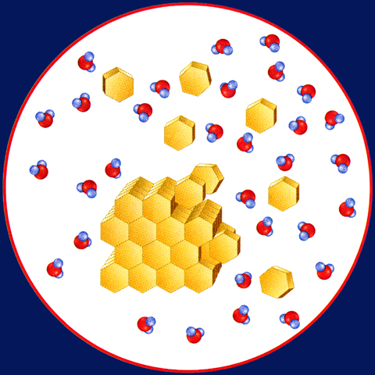
Chapter Assessment
The answer is C. All of the combinations are mixtures because the individual components retain their own properties. A solution is a mixture in which one or more substances is dissolved in another and will not settle out of solution.
Water molecules
Sugar molecules
Sugar crystal

Slide 47
Chapter Assessment
Question 4
What type of substance forms hydrogen ions in water?
A. enzyme
B. acid
C. base
D. polar

Slide 48
Chapter Assessment
The answer is B. Any substance that forms hydrogen ions (H⁺) in water is an acid. The pH of a substance is a measure of how acidic or basic a solution is.

Slide 49
Chapter Assessment
Question 5
Which of the following best describes a molecule with an unequal distribution of charge?
A. polar
B. acidic
C. basic
D. diffuse
NC: 2.02

Slide 50
Chapter Assessment
The answer is A. Each polar molecule has a positive end and a negative end. Polar water molecules attract ions and other polar molecules, and can dissolve many ionic compounds.
NC: 2.02

Slide 51
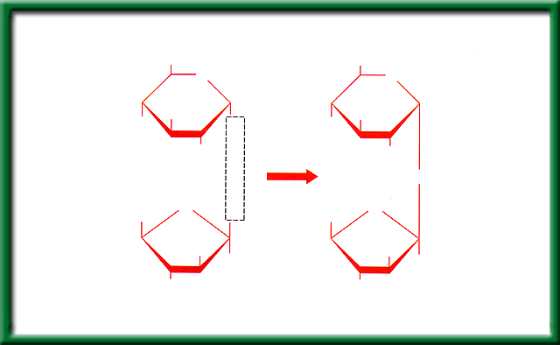
Chapter Assessment
Question 6
Name the chemical reaction illustrated in the diagram.
A. hydrolysis
CH₂OH
CH₂OH
Glucose
O
O
HO
OH
HO
OH
B. condensation
OH
OH
OH
+
O
+
H₂O
HOCH₂
O
OH
HOCH₂
O
C. Protein synthesis
Fructose
HO
CH₂OH
HO
CH₂OH
OH
OH
D. glycolysis
Sucrose
NC: 2.03

Slide 52
Chapter Assessment
The answer is B. In condensation reactions, small molecules bond together to produce a polymer and water.
CH₂OH
CH₂OH
Glucose
O
O
HO
OH
HO
OH
OH
OH
OH
+
O
+
H₂O
HOCH₂
O
OH
HOCH₂
O
Fructose
HO
CH₂OH
HO
CH₂OH
OH
OH
Sucrose
NC: 2.03

Slide 53
Chapter Assessment
Question 7
An oxygen atom has 8 protons and 8 neutrons. How many electrons does it have?
A. 8
B. 18
C. 32
D. 0

Slide 54
Chapter Assessment
The answer is A. Atoms contain equal numbers of electrons and protons and have no net charge.
Nucleus
8 protons (p+)
8 neutrons (n⁰)
Oxygen atom

Slide 55
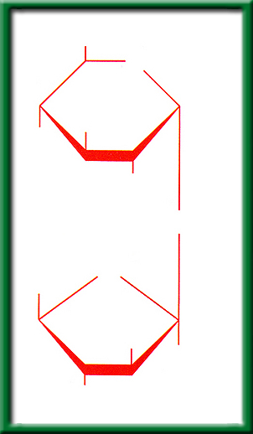
Chapter Assessment
Question 8
Based on your knowledge of biomolecules, which of the following substances would be most effective at breaking down this polymer?
CH₂OH
A. nuclease
O
OH
B. lipase
HO
OH
C. pepsin
O
O
D. water
HOCH₂
HO
CH₂OH
OH
NC: 2.01

