Slide 1
Atom Models
There are two models of the atoms we will be using in class.
Bohr Model
Lewis Dot Structure

Slide 2
Bohr Model
The Bohr Model shows all of the particles in the atom.
In the center is circles. Each circle represents a single neutron or proton. Protons should have a plus or P written on them. Neutrons should be blank or have an N.
In a circle around the nucleus are the electrons. Electrons should have a minus sign or an e.
-
+
+
-

Slide 3
Electrons have special rules….
You can’t just shove all of the electrons into the first orbit of an electron.
Electrons live in something called shells or energy levels.
Only so many can be in any certain shell.

Slide 4
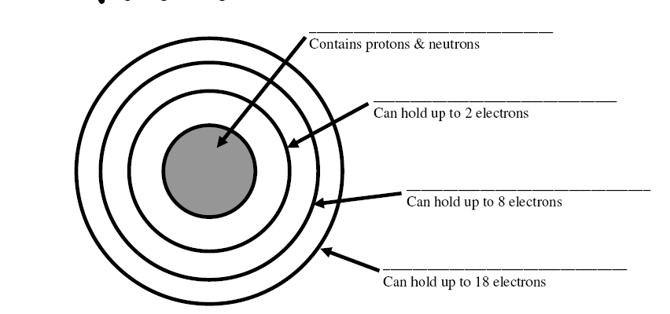
Nucleus
1st shell
2nd shell
3rd shell
Adapted from http://www.sciencespot.net/Media/atomsfam.pdf

Slide 5
Electrons have special rules….
You can’t just shove all of the electrons into the first orbit of an electron.
Electrons live in something called shells or energy levels.
Only so many can be in any certain shell.
The electrons in the outer most shell of any element are called valance electrons.

Slide 6
So let’s try it….
How to draw a Lithium atom
First, look at the Periodic Table
Second, determine the number of protons (Look @ the atomic number)
Then determine the number of neutrons (Atomic mass – atomic number)
Then determine the number of electrons (Look @ the atomic number)
3
Li
Lithium
7

Slide 7
So let’s try it….
Protons = 3
-
3
Li
Lithium
7
+
+
+
-
-
Electrons = 3
2 in the 1st shell, 1 in the 2nd shell
Neutrons = 4
(7-3=4)

Slide 8
Lewis Dot Structure
The Lewis Dot Structure is a bit different from the Bohr model.
It only shows the element symbol and it’s outer most electron shell.
-
-
-
+
-
+
+
+
-
+
+
+
+
-
-
-
•
•
•
O
•
• •

Slide 9
How to…
Write the symbol.
Start on the right hand side, working your way clockwise around the symbol.
Try Lithium

Slide 10
Your activity…
Using the beans (Purple e is an electron, Green P is a proton, and Orange N is a neutron), create a Bohr model , and then a Lewis dot structure model of each of the first 20 elements. After you have created each model, draw each model on your chart.
Hint to make a chart, create 3 columns on your paper. Label the columns: element, Bohr model, Lewis Dot.

