Slide 1
Electron Microscopes
The maximum magnification of light microscopes is usually ×1500, and their maximum resolution is 200nm, due to the wavelength of light.
Electrons have a much lower wavelength than light (100,000 times shorter in fact, at 0.004nm) which means that they can be manipulated fairly easily with magnets and used to produce an image with a resolution as great as 0.1nm. Electron microscopes can have magnifications of ×500000.

Slide 2
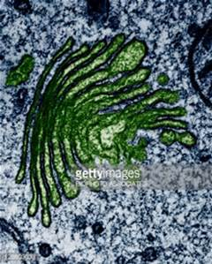
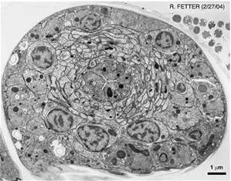
Transmission Electron Microscopes
A Transmission Electron Microscope (TEM) produces a 2D image of a thin sample of tissue, and has a maximum magnification of ×500,000.

Slide 3
Electron Microscopy Technique
The preparation of a sample for electron microscopy is a complex process. It may involve:
Chemical Fixation: Stabilizing an organism’s/sample's mobile macrostructure
Cryofixation: Freezing the sample very rapidly to preserve its state
Dehydration: Removing the water form a specimen, for example, by replacing it with ethanol
Embedding: Embedding in resin, ready to be sectioned
Sectioning: Cutting the sample into thin strips that are semitransparent to electrons, for example with a diamond or glass knife
Staining: Using heavy metals to scatter electrons and produce contrast
Freeze Fracturing: Freezing the sample rapidly, and then fracturing it, for example, when viewing cell membranes
Mounting: Placing the sample on a copper grid

Slide 4
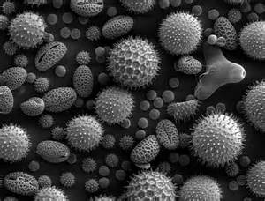
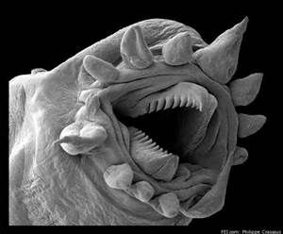
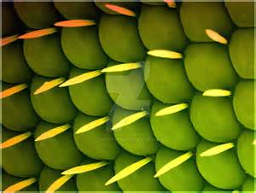
Scanning Electron Microscopes
A Scanning Electron Microscope (SEM) produces a 3D image of a sample by “bouncing” electrons off of the surface of the sample. This generates secondary electrons that are released from the sample that are detected with multiple detectors. It has a maximum magnification of about ×100,000.

Slide 5
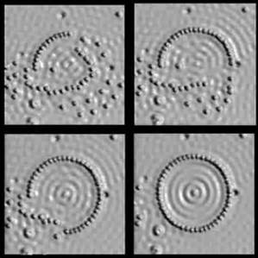
Scanning Tunneling Electron Microscope
The scanning tunneling microscope (STM) is a type of electron microscope that shows three-dimensional images of a sample. In the STM, the structure of a surface is studied using a stylus that scans the surface at a fixed distance from it.
Currents Control the Surface An extremely fine conducting probe is held close to the sample. Electrons tunnel between the surface and the stylus, producing an electrical signal. The stylus is extremely sharp, the tip being formed by one single atom. It slowly scans across the surface at a distance of only an atom's diameter. Recording the vertical movement of the stylus makes it possible to study the structure of the surface atom by atom. A profile of the surface is created, and from that a computer-generated contour map of the surface is produced. The study of surfaces is an important part of physics, with particular applications in semiconductor physics and microelectronics.

