Slide 1
DNA Technology

Slide 2
The Human Genome Project
1st task- determine the exact ____________ of all of the __________ (the A’s, T’s, C’s & G’s) in human DNA
2nd task- Identify which parts of the DNA code for __________________
This information was then used to begin creating linkage maps which show the exact location of genes on a chromosome.

Slide 4
Applications of the Human ____________ Project
Diagnosis of ________ _______________: Cells from an adult or fetus can be used to test for certain genetic disorders.

Slide 5
II. ____________________________ modifying the genes of an organism
In many cases, the genes are modified by inserting genes from another organism. Another term for this process is ________________________ ______________________________

Slide 6
A. _________________ inserting a normal/working gene into human cells to correct genetic disorders.
________________ are often used as a ____________ (which is a way of delivering new genes to existing cells)

Slide 7
___________________ inserted into viral DNA.
Viruses infect human cell.
______________ delivers new DNA into human cells.

Slide 8
Some problems with initial trials of gene therapy included:
The gene didn’t stay ______________ for very long.
The cells didn’t ________________ very long.
The treatment had to be _________________ often.

Slide 9
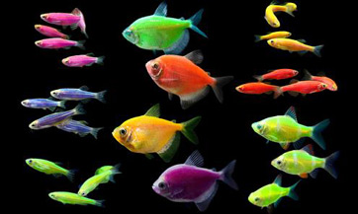
B. _____________ _________________ An organism that contains the DNA from a different species.

Slide 10
Transgenic Animals
__________________ , roundworms, and mice are used extensively to study ___________ diseases.

Slide 12
Transgenic Plants (Agriculture)=
Early experiments produced:
Ex. 1 : A _________ plant with a _____ __________…The result was a plant that glows in the dark.

Slide 13
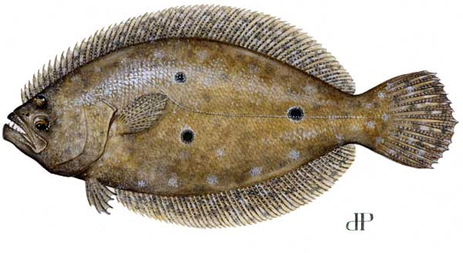
Ex 2: A ___________ which contains an ‘antifreeze’ gene isolated from a __________________…The result was a strawberry plant that is able to survive in colder climates (survives frost).
+

Slide 14
Today GM (________ ______________) crops are made to be:
Pesticide tolerant (such as BT corn)
_____________ resistant (some plants make their own pesticide)
_____________tolerant

Slide 15
Inserting foreign DNA into a host cell (Gene Splicing)
To help explain this, we will refer to genetically modified bacteria that are used to make insulin for ____________________________ patients.
Since bacteria don’t know how to make human insulin, we must put the instructions (or genes) for it into the bacteria.

Slide 16
3
Step # ____: Human gene is spliced into plasmid.
Step # ____: Bacteria cell with new gene divides.
Step # ____: Plasmid is removed from bacteria cell.
Step # ____: The desired gene is cut from out from human DNA.
Step # ____: Bacteria cell division continues.
Step # ____: The plasmid is put back into the bacteria cell.
5
1
2
6
4

Slide 17
Once the plasmid is removed from the bacteria, a ___________________________ is used to cut open the DNA (step 1)
There are many different kinds of restriction enzymes, and each one works like a special pair of scissors that leaves a specific pattern wherever it cuts DNA.

Slide 18
Why might it be important to use the same enzyme in step 1 and step 2?
So that they ends will be complimentary and match up.

Slide 19
Bacteria that successfully take in the insulin making gene will reproduce (by binary fission) and make more bacteria cells that also know how to make _________________.
Variations of this process are used to make many other pharmaceutical products such as _____ ____________________

Slide 20
DNA Fingerprinting
A ______________________________is a unique pattern of bands formed by the fragments from an organism’s DNA.
Used for evidence at a _____________ scene.
Used in establishing ___________________ between two individuals.
Used in classification to compare closeness between _____________________________.

Slide 21
To make DNA fingerprint two processes are typically used
______________________________________(restriction fragment length polymorphism)- using a restriction enzyme to cut the DNA into small pieces.
Running DNA in a _____________________ _____________. A gel is used to separate the pieces of DNA made by the restriction enzyme. This makes a unique set of bands

Slide 22
1. DNA from blood or other tissue is cut into various and unique lengths by specific restriction enzymes (this is called RFLP Analysis).
2. Next, a gel (with a consistency similar to gelatin) is formed; leaving __________________(or holes) open at one end.
3. Small amounts of ____ _______________ (from the RFLP analysis) are placed into these wells.

Slide 23
4. The gel is placed into a solution and ________________________is run through the gel. The end of the gel with the wells in it is negatively charged and the opposite end is positvely charged.
The __________________ charged DNA fragments travel toward ______________________ end of the gel.
The smaller the fragment, the faster it moves through the gel. Fragments that are the farthest from the well are the smallest.
5. A stain which sticks to DNA is put on the gel. This allows the bands to appear clearly.

Slide 24
The end result is a unique ________ ___________or “DNA fingerprints” in the gel.

Slide 25
Ex: The Howard’s house was broken into and robbed last week. Detectives carefully dusted for fingerprints, but the only ones found in the house belonged to the family members.
It appeared that the burglar got into the house by breaking the front window. As luck would have it, several drops of blood were left on the glass.
Detectives had 4 suspects & were able to obtain a sample of DNA from each one.
The result was the following DNA fingerprint:
Well A: Marker / Ladder
Well B: Suspect #1
Well C: Suspect #2
Well D: Suspect #3
Well E: Suspect #4
Well F: Blood found at the crime scene.
Well G: Marker / Ladder

Slide 26
Did one of the above suspects commit the burglary? If so, which one?
Yes, ______________.
What is the purpose of Well A & G?
They serve as a _____________.

Slide 27
Answer the three questions below using the 3 gels on the top of the previous page:
Gel A: Which suspect left evidence at the scene of the crime?
______

Slide 28
Gel C: Which deer species (1,2 or 3) is most closely related to the common ancestor?
__________________

Slide 30
Stevenson

Slide 31
Stevenson
Jones

Slide 32
Stevenson
Jones
Smith

Slide 35
Which sheep is the source of the nucleus in the fused cell?
Which sheep provided an egg cell?
Why was the nucleus removed from the egg cell?
Which animal in the above diagram is a clone?
Which two animals are genetically identical?
Provide at least 2 example of how clones are produced in nature (not a lab)/
Does the lamp receive any genetic material from sheep C?
If you only had one sheep, instead of three (A,B, and C) above, would it still be possible to make a clone? If so, which one would it have to be?
Can a male be used in the cloning process? If so, what roles could he be used for (A, B and/or C?)

Slide 36
Which sheep is the source of the nucleus in the fused cell?
-Sheep A
Which sheep provided an egg cell?
-B
Why was the nucleus removed from the egg cell?
-It was missing half of the genetic information that was needed that is necessary to make a clone. (Wanted A’s DNA).
Which animal in the above diagram is a clone?
-Lamb

Slide 37
Which two animals are genetically identical?
-Lamb and Sheep A
Provide at least 2 example of how clones are produced in nature (not a lab)
-Identical twins, bacteria (binary fission), asexual reproduction (mitosis)
Does the lamp receive any genetic material from sheep C?
-No, it just lets the cell grow. (Acts as a surrogate).
If you only had one sheep, instead of three (A,B, and C) above, would it still be possible to make a clone? If so, which one would it have to be?
-Yes, it would have to be a female.
Can a male be used in the cloning process? If so, what roles could he be used for (A, B and/or C?)
-Yes, he could be A the nucleus donor.

