Slide 1
CLASSIFICATION

Slide 2
Biological Classification
Classification
Grouping of things based on similarities
Taxonomy
Scientific classification of an organism based on traits
Structure
Behavior
Development/embryology
DNA
Methods of obtaining food
Geographic distribution

Slide 3
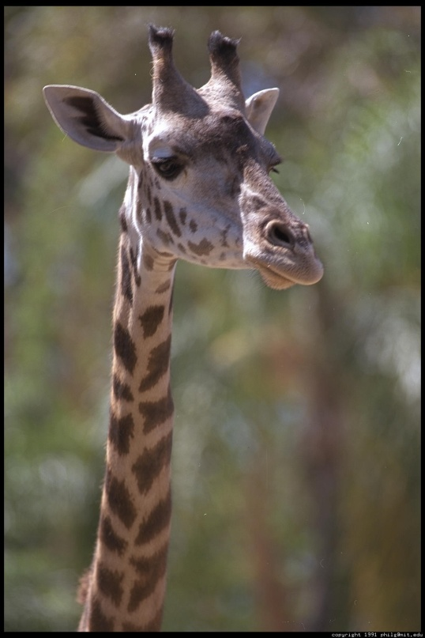
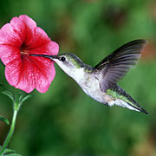
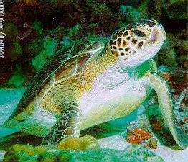
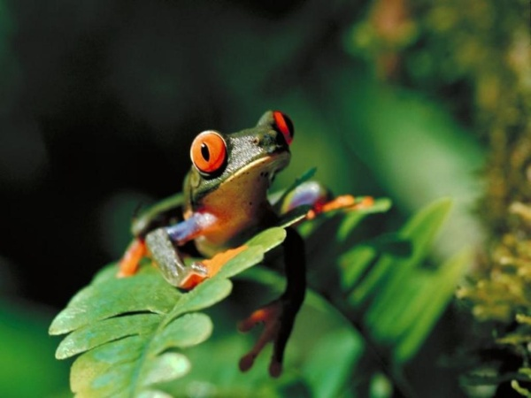
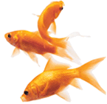
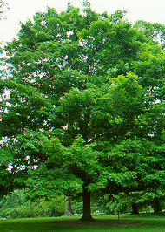
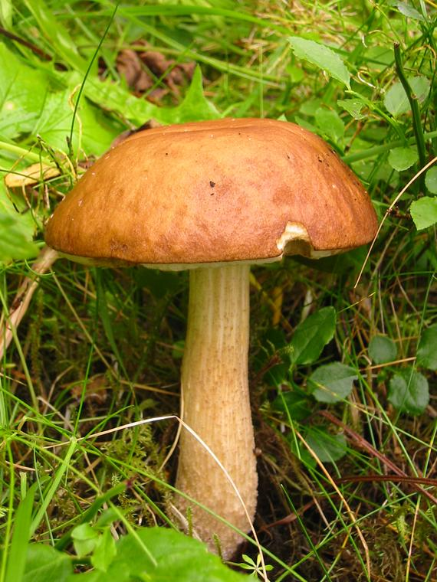
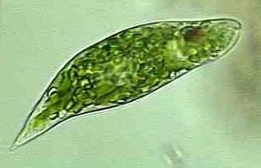
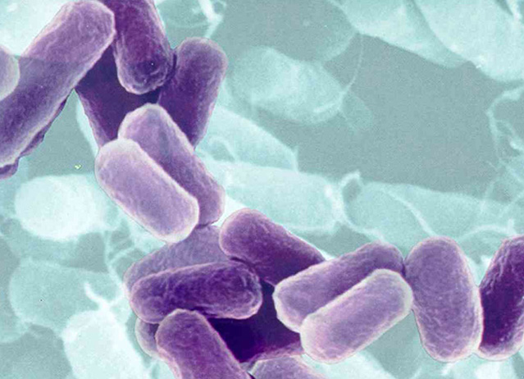
Diversity of Life

Slide 4
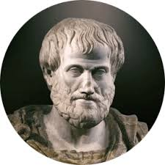
Early Classification
Aristotle
First classification system; included plants and animals
Grouped animals based on habitat
Problem; animals are mobile
Grouped plants based on size; herb, shrub or tree
Problem; plants grow
System did not accurately describe/include all organisms, nor did it reflect the evolutionary relationships between organisms

Slide 5
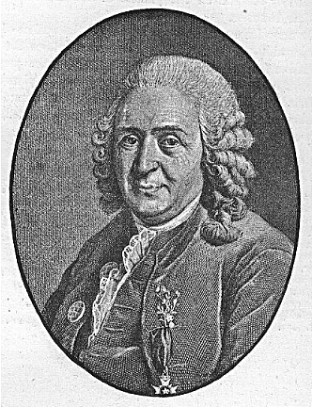
Carolus Linnaeus
Developed a classification system that is the basis for our modern system of classification (1700’s)
Initially he divided organisms into two kingdoms; plants and animals
Based his classification on structure, which reflected similarities among organisms
Used taxa, or classification categories
Used binomial nomenclature

Slide 6
Heirarchy of Classification Taxa
Kingdom; group of related phyla
Phylum (Division for plants); group of related classes
Class; group of related orders
Order; group of related families
Family; group of related genera
Genus; group of related species
Species; group of organisms capable of interbreeding to produce fertile offspring

Slide 7
6 Kingdoms (Modern)
Eubacteria
Archaebacteria
Protista
Fungi
Plantae
Animalia

Slide 8
System of Classification
Binomial nomenclature
Two name naming system to identify an organism
1st word is the genus
2nd word is the specific epithet, a descriptive term
Scientific name (genus and specific epithet) italicized or underlined
Genus capitalized, specific epithet lower case
In Latin; dead language, not subject to change, root language

Slide 9
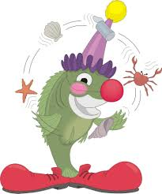
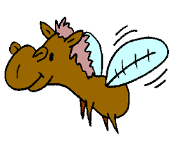
Common Names
Common names are general names given to organisms that are random, vary with location, are not standardized and may be misleading
Ex. Clown fish, horsefly, sea cucumber, lady bug etc.

Slide 10
Scientific Names
Two different species of butterflyfish, same genus
Chaetodon longirostris (long-nose butterflyfish)
Chaetodon ocellata (spotfin butterflyfish)

Slide 11
Example of Classification
Common Name – Killer Whale
Kingdom – Animalia
Phylum – Chordata
Class – Mammalia
Order – Cetacea
Family – Delphinidae
Genus – Orca
Species - orcinus

Slide 12
Human (???) Classification
Kingdom – Animalia
Phylum – Chordata
Class – Mammalia
Order – Primate
Family – Homindae
Genus – Homo
Species – sapiens

Slide 14
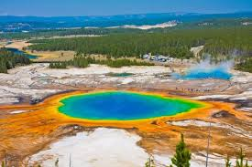
Kingdom Archaebacteria
Prokaryotes
Methanogens, halophiles, thermophiles; also found in other areas
Unicellular organisms; bacteria
Most heterotrophs, some autotrophs (photo/chemo.)

Slide 15
Eubacteria
Differ from Archaebacteria due to differences in cell membranes, cell wall and nucleotide sequences
Prokaryotic
Found in almost all habitats on Earth
Photosynthetic, chemosynthetic, heterotrophic

Slide 16
Kingdom Protista
Eukaryotes
Have nucleus
Most unicellular, some live in colonies, some multicellular
If organism is not an animal, plant, fungus or bacterium, then it is a protist

Slide 17
Kingdom Fungi
Eukaryotes
Unicellular and multicellular organisms
Have cells with cell walls made of chitin
Most are decomposers
Some parasitic
Are NOT photosynthetic

Slide 18
Kingdom Plantae
Eukaryotes
Multicellular
Have cells with cell walls made of cellulose
Photosynthesize

Slide 19
Kingdom Animalia
Eukaryotes
Multicellular
Have cells without cell walls
Heterotrophs

Slide 20
Identification of Organisms
Dichotomous Key – tool designed to assist people with the identification of living things
Series of steps with a set of two choices that are opposite
Start off being general and become more specific
Use steps and choices given in the key to identify an organism based on traits

Slide 21
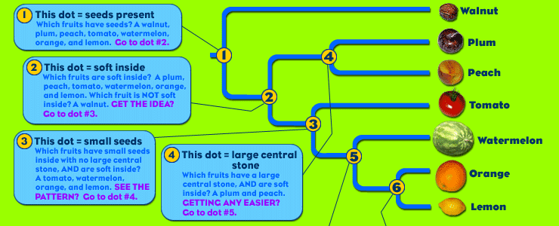
Cladogram
Reflects a group of organisms with a last common ancestor; gives clues as to the evolution of characteristics

Slide 22
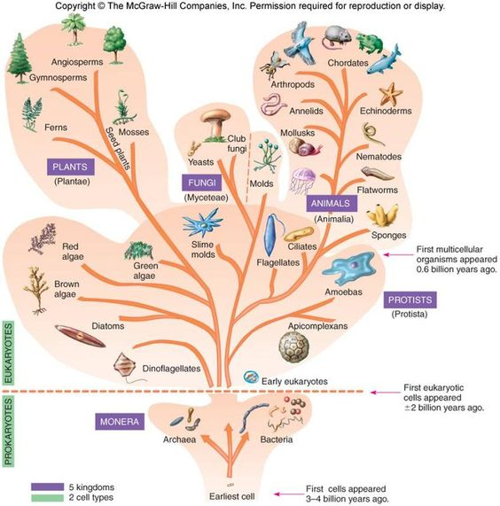
Fan Diagram
Organisms that branch off closer to the edge have evolved more recently than those closer to the center

