Slide 1
Cell Specialization

Slide 2
Differences Among Cells
All living things are composed of cells
Differences arise from the way the cells are specialized and the ways in which cells associate with each other

Slide 3
Unicellular Organisms
Made up of a single cell
Don’t have to worry about communication

Slide 4
Multicellular Organisms
Made up of many cells
Depend on cell specialization
Depend on cell communication
Depend on cell cooperation

Slide 5
Cell Specialization
Cells throughout an organism can develop in different ways to perform different tasks
There are approximately 250 types of specialized cells in human body

Slide 6
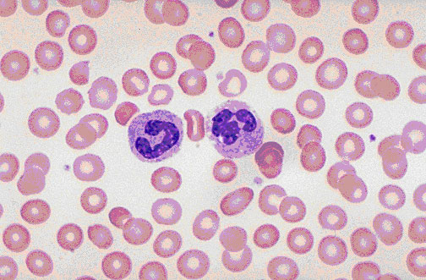
Red Blood Cells
Specialized for carrying O₂ to the tissues
Loaded with hemoglobin, an O₂ carrying protein
Have lost their nuclei and mitochondria, because they don’t need them

Slide 7
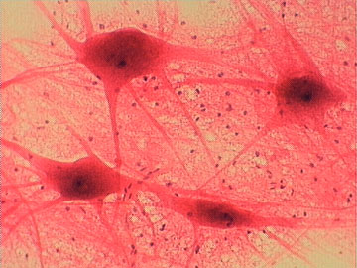
Nerve Cells
Specialized for transmitting electrical impulses
Have long axons- may be a meter or more in length
Have specialized Na and K channels for generating electricity
Only a single nucleus in the cell body

Slide 8
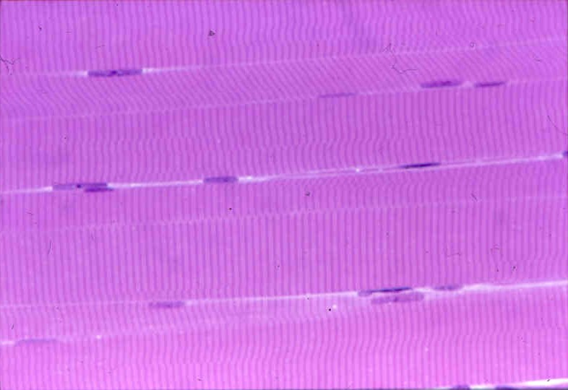
Muscle Cells
Specialized for producing force by contraction
Very long cells
Often attached to 2 bones
Formed by fusion of many smaller cells; contain many nuclei

Slide 9
Cell Structure & Function
Form follows function
The shape of a cell is directly related to the task that it performs

