Slide 1
Cell organelles

Slide 2
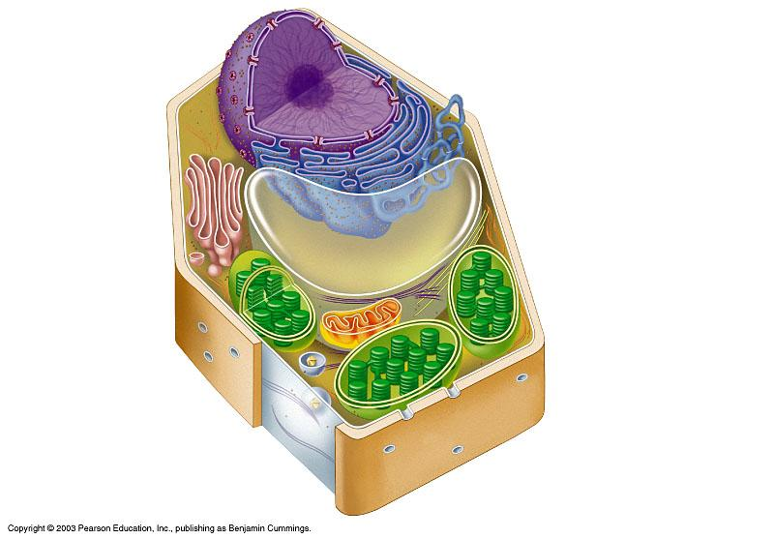
Plant Cell
Rough endoplasmic reticulum
Nucleus
Ribosomes
Smooth endoplasmic reticulum
Golgi apparatus
Microtubule
Central vacuole
Not in animal cells
Intermediate filament
Cytoskeleton
Chloroplast
Microfilament
Cell wall
Mitochondrion
Peroxisome
Plasma membrane

Slide 3
Cell wall
Rigid membrane around plant cell
Made of cellulose
Provides shape and support

Slide 4
plastids
Group of structures used in photosynthesis and product storage
Chloroplasts
Leukoplasts
Chromoplasts
Have a double membrane
Provide color and cellular energy

Slide 5
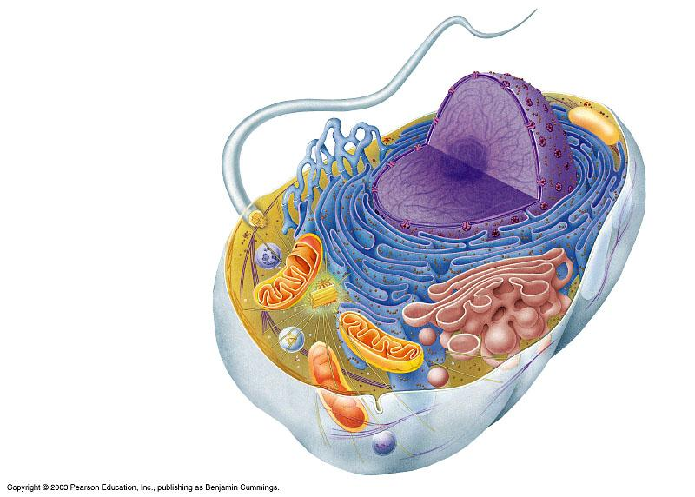
Animal cell
Smooth endoplasmic reticulum
Nucleus
Rough endoplasmic reticulum
Flagellum
Not in most plant cells
Lysosome
Centriole
Peroxisome
Ribosomes
Golgi apparatus
Microtubule
Cytoskeleton
Intermediate filament
Plasma membrane
Microfilament
Mitochondrion

Slide 6
Cell membrane
Membrane surrounding cell
Allows some molecules to pass through

Slide 7
Cytoplasm
Jelly-like substance in the cell around the nucleus and organelles

Slide 8
nucleus
Control center of the cell
Location of hereditary information

Slide 9
Nuclear parts
Nucleolus
Dense body in the nucleus
Site of ribosome production
Nuclear Envelope
Double membrane that surrounds the nucleus
Fused at certain point to create nuclear pores
Outer membrane continuous with ER
Nuclear Pores
Cluster of proteins that form a channel that regulates the passage of RNA to the cell’s cytoplasm

Slide 10
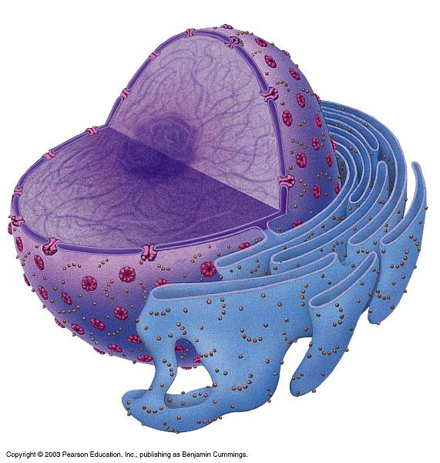
NUCLEUS
Chromatin
Two membranes of nuclear envelope
Nucleolus
Pore
ROUGH ENDOPLASMIC RETICULUM
Ribosomes

Slide 11
Endoplasmic reticulum (ER)
Folded membranes
Rough ER – has ribosomes
Smooth ER – no ribosomes
Transport of RNA and proteins

Slide 12
Rough ER
Arranged into flattened sacs
Ribosomes on surface give it a rough appearance and produce proteins
Manufactures membranes
Cells that specialize in secreting proteins have lots of rough ER

Slide 13
Ribosomes
Structures that manufacture proteins
Found on Rough ER and floating in cytoplasm

Slide 14
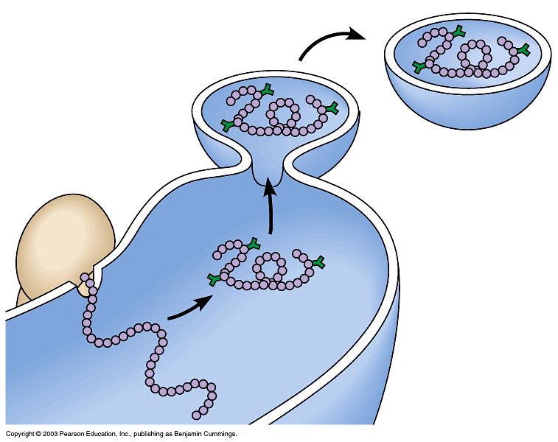
Transport vesicle buds off
4
Ribosome
Secretory (glyco-) protein inside transport vesicle
Sugar chain
3
Glycoprotein
1
2
ROUGH ER
Polypeptide

Slide 15
Smooth ER
A series of interconnected tubules
No ribosomes on surface
Synthesizes Lipids
In some cells, it regulates carbohydrate metabolism and breaks down toxins and drugs

Slide 16
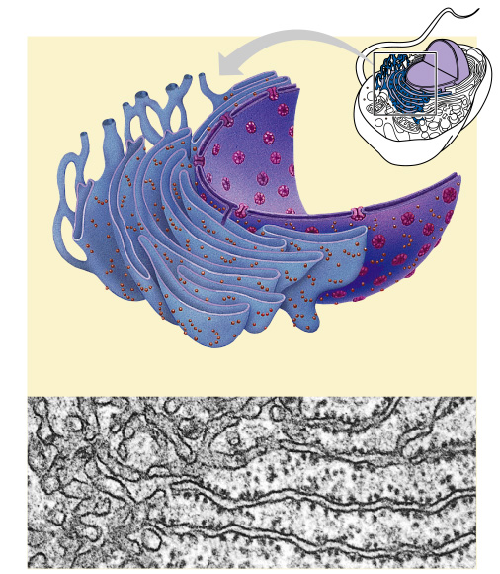
SMOOTH ER
ROUGH ER
Nuclear envelope
Ribosomes
SMOOTH ER
ROUGH ER

Slide 17
Golgi bodies
Flattened membrane sacs
For synthesis, packaging, and distribution
Put finishing touches on proteins and lipids that arrive from ER
Package finished material for shipment to final destinations
Material arrives and leaves in vesicles

Slide 18
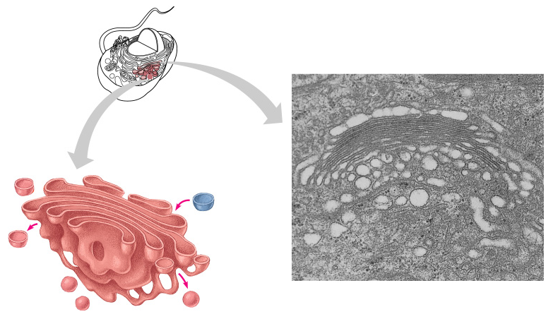
Golgi apparatus
Golgi apparatus
“Receiving” side of Golgi apparatus
Transport vesicle from ER
New vesicle forming
“Shipping” side of Golgi apparatus
Transport vesicle from the Golgi

Slide 19
Vacuoles
Spherical storage sac for food and water

Slide 20
lysosomes
Spherical sac containing enzymes
Digestive functions
Digest food
Destroy bacteria
Recycle damaged organelles

Slide 21
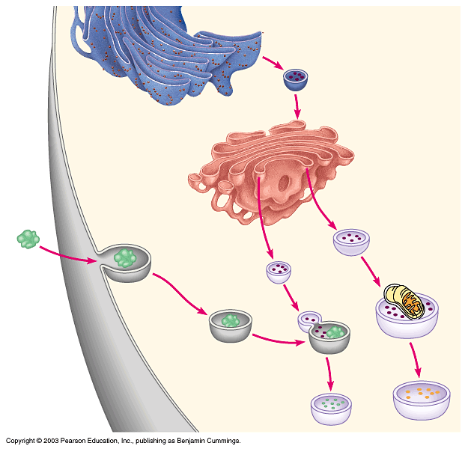
Rough ER
Transport vesicle (containing inactive hydrolytic enzymes)
Plasma membrane
Golgi apparatus
Engulfment of particle
Lysosome engulfing damaged organelle
“Food”
LYSOSOMES
Digestion
Food vacuole

Slide 22
mitochondria
Energy (ATP) producing powerhouses
Rod shaped double membranous structure
Where cellular respiration takes place
Reactions that occur here require oxygen
Have lots of internal folds (cristae) that increase surface area
Allows for more chemical reactions in a smaller space

Slide 23
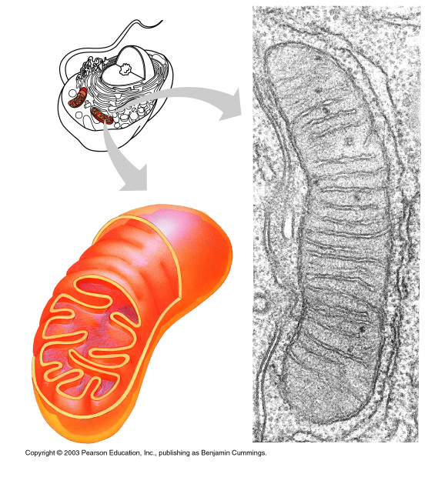
MITOCHONDRION
Outer membrane
Intermembrane space
Inner membrane
Cristae
Matrix

Slide 24
Microfilaments and microtubules
Fibers and tubes of protein
Help move internal cell parts

Slide 25
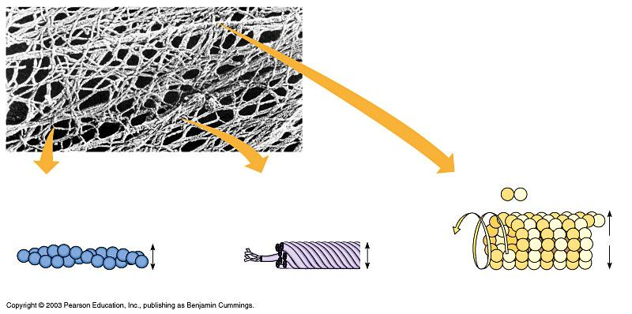
Tubulin subunit
Actin subunit
Fibrous subunits
25 nm
7 nm
10 nm
MICROFILAMENT
INTERMEDIATE FILAMENT
MICROTUBULE

Slide 26
Centrioles
Short tubes
For cell reproduction

Slide 27
cilia
Short, hair-like extensions on surface of some cells
Used for movement and food gathering

Slide 28
flagella
Long, whip-like extension on the surface of some cells
Used for movement

Slide 29
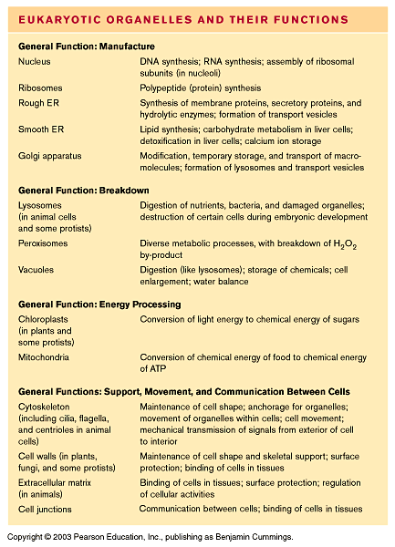
Notes:
* Eukaryotic organelles fall into 4 functional groups.

