Slide 1
Cell Membrane and Cellular Transport

Slide 2
Solutions
Liquid mixtures of _______________ dissolved in _______________
Ex. Salt Water
Solute – salt
Solvent – water
Ex. Interior of Cell
Solute – salts and minerals
Solvent - cytoplasm

Slide 3
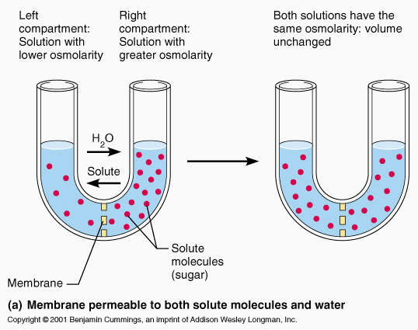
Maintaining ____________________
Cell function depends on maintaining the concentration of solutes in the cytoplasm
Too _________ or too _____________ causes damage to cell
Cell tries to maintain balance of solutes

Slide 4
Hormones
_____________________ are important in regards to the cell maintaining a proper balance of solutes and solvents
They are chemical messengers that regulate bodily functions in multicellular organisms
Help maintain ________________________________
Control movement of oxygen into cells
Control removal of carbon dioxide from cells
Help maintain internal temperature
Regulate fluids

Slide 5
Cell Membrane
The _____________________________________________also helps to maintain homeostasis by regulating the solute/solvent balance
Regulates movement of materials in and out of cell
Semi-Permeable or Selectively Permeable
Only certain substances can go through

Slide 6
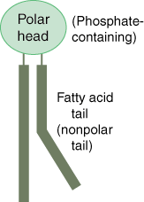
Phospholipid Bilayer of the Cell Membrane
___________________________ – phosphorous bonded with oxygen
Hydrophillic
Means “__________________ loving
Are the head regions of the fatty acids
2 ____________________(lipid) tails
Hydrophobic
Means “water hating”
Refers to fatty acid tails

Slide 7
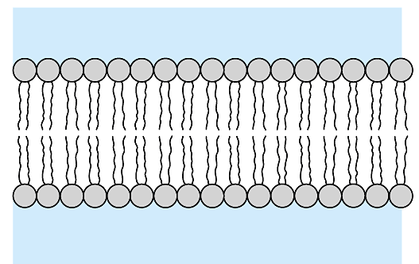
Phospholipid Bilayer
Phospholipids are arranged in a ____________________ ___________________
Heads point out, tails point in
Hydrophilic heads
Water
Hydrophobic tails
Water

Slide 8
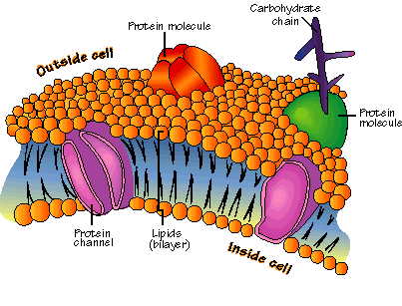
Phospholipid Bilayer
Globular _____________________________________________
Transport substances through membrane

Slide 9
______________________ Transport
Does not require energy
Molecules move spontaneously through the cell membrane
Move with the concentration gradient
Move from areas higher concentrations to areas of lower concentrations

Slide 10
Types of Passive Transport
______________________________
Facilitated Diffusion
______________________________

Slide 11
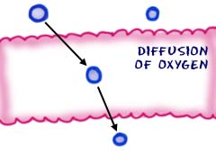
Diffusion
Process by which substances move __________________________ through the cell membrane

Slide 12
Facilitated Diffusion
Involves the help of a channel or _______________________________________to move a substance from one side of the cell membrane to the other

Slide 13
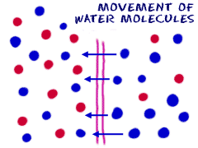
Osmosis
Movement of ______________ from an area of high water concentration to an area of low water concentration through a ______________________ ______________________ membrane

Slide 14
Types of Solutions
There are three different types of solutions that will cause osmosis to occur:
________________________________
Hypo means under or less than
This means the solution has a lower concentration of solute, as compared to the cell
The solution has a higher concentration of water
____________________________________
Hyper means above or more than
This means the solution has a higher concentration of solute, as compared to the cell
The solution has a lower concentration of water
___________________________________
Solute concentration is the same inside and outside of the cell

Slide 15
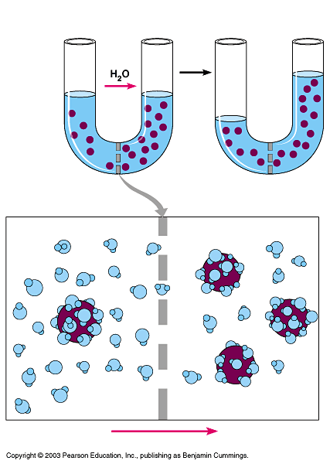
Movement of Water
Hypotonic solution
Hypertonic solution
Water ________________ across a cell membrane from hypotonic to hypertonic
Selectively permeable membrane
Solute molecule
HYPOTONIC SOLUTION
HYPERTONIC SOLUTION
Water molecule
Selectively permeable membrane
Solute molecule with cluster of water molecules
NET FLOW OF WATER

Slide 16
Hypotonic Solution
In a ____________________________________ solution, water will flow into a cell, because the cell has more dissolved solutes that need to be diluted to maintain equal concentrations on both sides of
the cell membrane
Net water gain
Cell ______________

Slide 17
Hypotonic Results
In animal cells, the cell _______________ and eventually the cell membrane can _____________
This is called cytolysis (“cell” “splitting”)
To prevent this, freshwater protists, such as an amoeba, have special organelles called contractile vacuoles that act as water pumps
In plant cells, as water moves in, _______________pressure increases and cells get firm as the cell membrane pushes against the cell wall
Plant cells usually do not split

Slide 18
Hypertonic Solution
In a _______________________________ solution, more water goes out of the cell than in
Net water loss
Cells shrinks

Slide 19
Hypertonic Results
In animal cells, as water _________________, the cell __________________________________________________
This is called ___________________________.
In plants cells, there is a loss of turgor pressure and the cell membrane pulls away from the cell wall; this is called plasmolysis
Prolonged plasmolysis results in wilting and cell/plant death

Slide 20
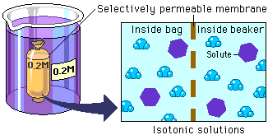
Isotonic Solution
______________________ amounts of water move in and out of cell
Concentrations remain the same both inside and outside of the membrane
This condition is called dynamic _________________.

Slide 21
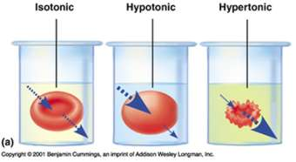
Red Blood Cells in Solutions

Slide 22
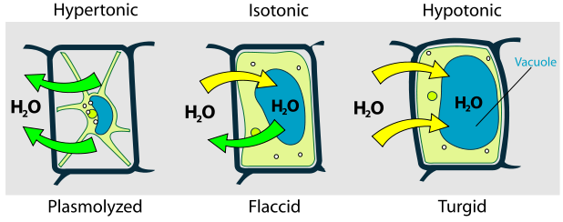
Plant Cells in Solutions

Slide 23
Examples of Diffusion
Kidney Dialysis
Medical procedure that involves diffusion
Food preserved by ______________________
Sugar curing
Pickling

Slide 24
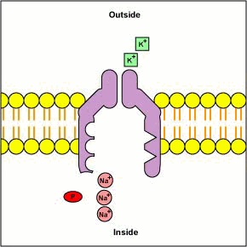
Active Transport
Movement of substances from an area of low concentration to an area of high concentration
Materials are moved across the cell membrane ___________________________________ the concentration gradient; going against “the flow”
Cell _________________________
(like swimming upstream)

Slide 25
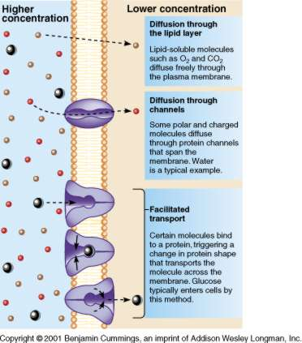

Slide 26
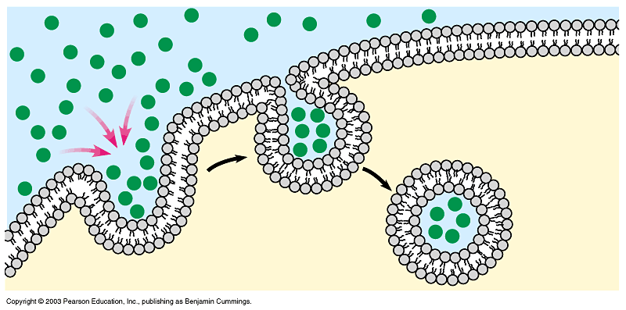
Endocytosis
Form of _____________________________________________
Brings materials into the cell
Membrane folds itself around substance
Creates a ________________________________
Brings substance into the cell
Amoeba obtains food this way

Slide 27
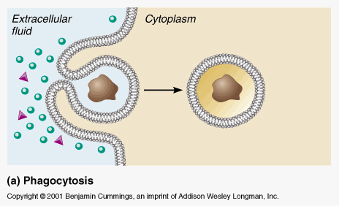
Endocytosis
When liquids are taken in, it is called __________________________________. When solids are taken in, it is called ______________________________.

Slide 28
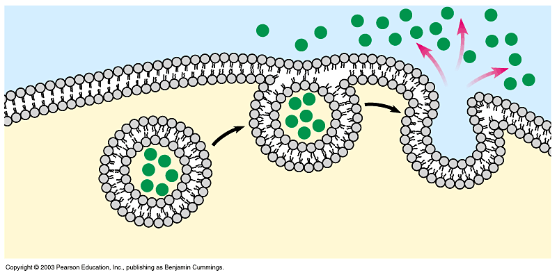
Exocytosis
Form of ________________________________________
__________________________________ materials from cell
Sac stores materials to be removed
Sac moves near cell membrane
Cell membrane opens
Substance is expelled from cell
Waste materials
Proteins
Fats

Slide 29
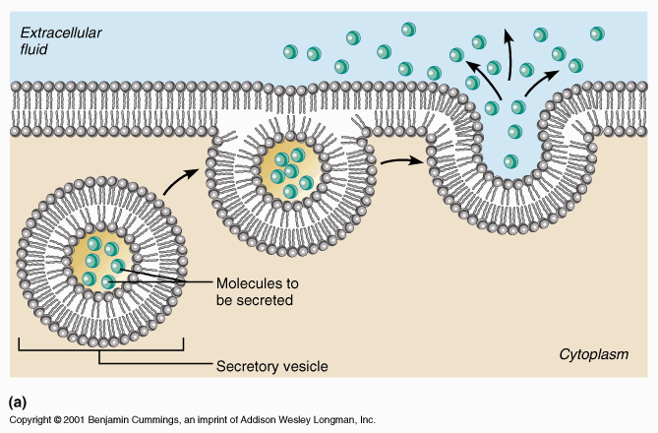
Exocytosis

