Slide 1
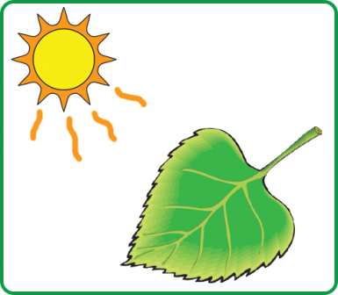
Cell Energy
All organisms must be able to obtain energy from the environment in which they live.
Some organisms are capable of producing their own food. These organisms are called autotrophs.
Photosynthetic; convert sunlight into chemical energy
Ex. Plants, algae, cyanobacteria
Chemosynthetic; convert inorganic molecules into chemical energy
Ex. Certain groups of bacteria

Slide 2
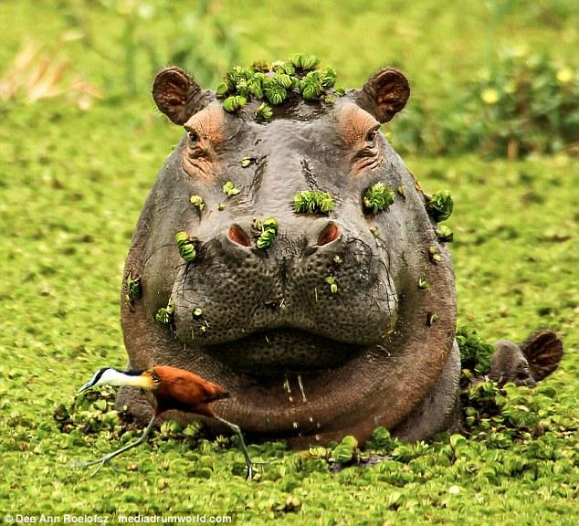
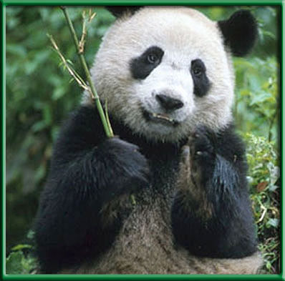
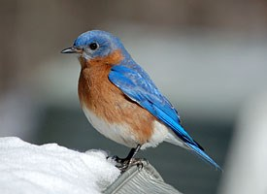
Cell Energy
Other organisms cannot make their own food, so they must eat plants and other organisms to obtain energy. These organisms are called heterotrophs.
Ex. Hippo, bluebird, cat, panda

Slide 3
The Need for Energy
Organisms require energy for all metabolic processes such as active transport, cell division, the production of proteins, digestion, development etc.
Glucose is the universal cellular fuel for almost all organisms. But, glucose cannot be used directly for energy. It must first be converted by the mitochondria into an energy packed molecule called ATP.

Slide 4
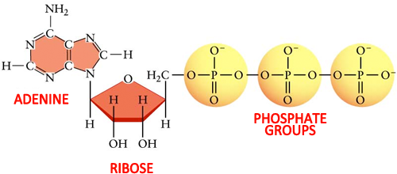
ATP
ATP stands for adenosine triphosphate. This molecule consists of the sugar ribose, the nitrogen base adenine, and three phosphate molecules.

Slide 5
How Does ATP Store Energy?
The energy that is stored in ATP is found in the chemical bonds that attach the three phosphate groups. The phosphate groups all have a positive charge. When they are brought close to each other, they behave like magnets and the like charges repel each other. So, to force the molecules together (like compressing a spring), energy is required that is stored in the bonds.

Slide 6
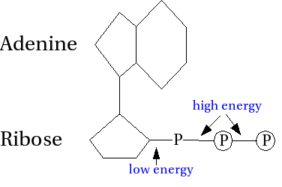
Forming ATP
When one phosphate group is added, AMP, or adenosine monophosphate , is formed
When two phosphate groups are added, ADP, or adenosine diphosphate, is formed
When three phosphate groups are added, ATP, or adenosine triphosphate, is formed.
ATP holds the most stored energy,
particularly in the third bond, although
ADP has a fair amount of energy

Slide 7
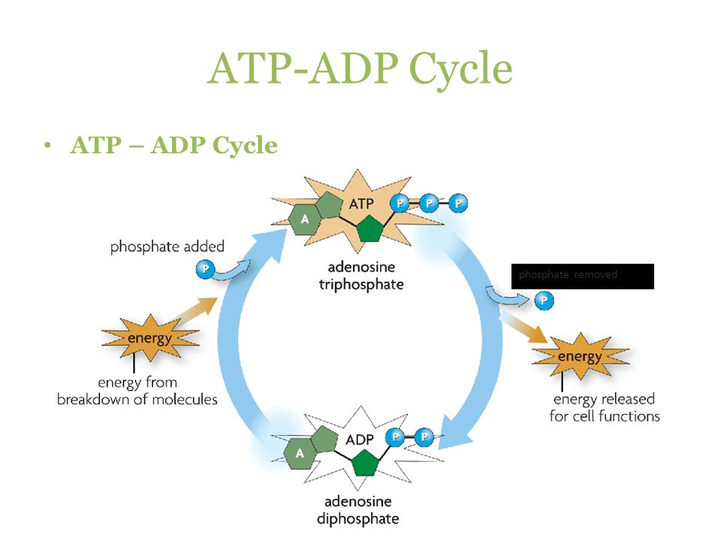
Using ATP
When the cell requires energy,
it breaks the bond in ATP
that holds on the third
phosphate group, to form ADP.
To store energy, one phosphate
group is bonded to ADP; ADP
can be recycled!

Slide 8
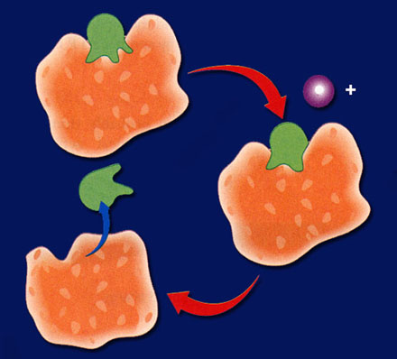
Using the Energy in ATP
When ATP is broken down and energy is released, the energy must be captured and used efficiently by cells.
Many proteins (enzymes) have a specific site where ATP can bind
So, when the third phosphate
bond is broken and energy is
released, the cell can use the
Energy for digestion, active
transport, making fats, converting
glucose etc.
ATP
p
Energy
ADP
ADP

Slide 9
Using the Energy in ATP
When ATP has been broken down to ADP, the ADP is released from the binding site in the protein and the binding site may then be filled with another ATP molecule

Slide 10
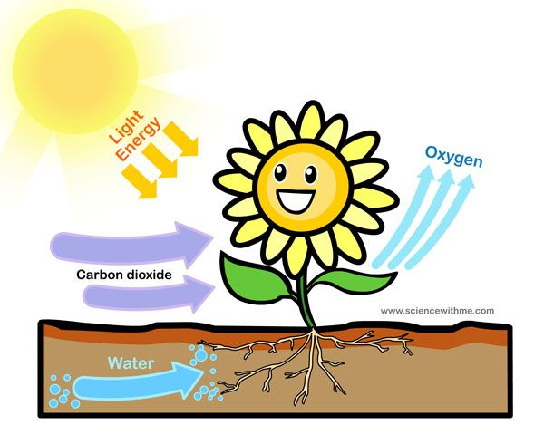
Energy From Sunlight
The process that converts the sun’s radiant energy into chemical energy in the form of simple sugars is called photosynthesis.

Slide 11
Photosynthesis
The chemical equation for photosynthesis is:
6CO₂ + 6H₂O → C₆H₁₂O₆ + 6O₂
The reactants that are required for this reaction are carbon dioxide and water.
The products of this reaction are glucose and oxygen

Slide 12
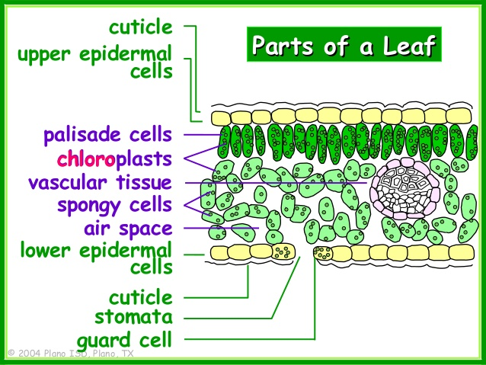
Leaf Structure
In plants, photosynthesis
takes place primarily in the
leaves in organelles called
chloroplasts. The palisade
mesophyll has the highest
concentration of chloroplasts,
so photosynthetic rate is
greater there.

Slide 13
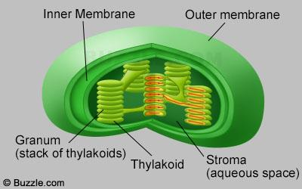
Chloroplast Structure
Chloroplasts have two major parts. The light dependent reactions take place in thylakoid membrane stacks called grana. The light independent reactions take place in the liquid matrix surrounding the grana called the stroma.

Slide 14
Phases of Photosynthesis
Photosynthesis occurs in two general phases;
Light dependent reactions; convert light energy into chemical energy in the form of ATP (in the grana)
Light independent reactions; incorporate CO₂ and use ATP from the light dependent reactions to make glucose (in the stroma)

Slide 15
Light Dependent Reactions
To trap the radiant energy in sunlight, thylakoid membranes contain several types of pigments, molecules that can absorb specific wavelengths of light
These pigment molecules make up a photosystem; the most common pigment is chlorophyll
Chlorophyll absorbs all colors of white light (best at blue and red) except green, which it reflects. That is why leaves appear green.
White light is made up of ROYGBIV; having accessory pigments helps chlorophyll absorb more energy from sunlight

Slide 16
Light Dependent Reactions
As sunlight strikes a leaf, its energy penetrates to the molecules in a photosystem. This transfer of energy to chlorophyll causes its electrons to vibrate and become energized or excited. This causes the electrons to leave chlorophyll and be transferred through a series of proteins embedded in the thylakoid membrane called an Electron Transport Chain (ETC).

Slide 17
Light Dependent Reactions
At each protein “step”, the electrons lose energy. This energy can be used to make ATP from ADP, or pump hydrogen ions into the center of the thylakoid disc (which indirectly helps make ATP).
Electrons are re-energized and pass down a second ETC
The electrons are transferred to the stroma using a carrier molecule called NADP⁺; it combines with two electrons and a hydrogen ion to become NADPH

Slide 18
Restoring Electrons
Chlorophyll is not happy that it has lost its electrons and wants them back. So, water is split (called photolysis) in the first photosystem.
When water is split;
Electrons are returned to chlorophyll
H⁺ ions are pumped into the thylakoid
O₂ is released into the air and we use it for respiration

Slide 19
Sun
Light energy transfers to chlorophyll
Sun
Chlorophyll passes energy down through the
electron transport chain.
Energized electrons provide energy that
H₂O splits
bonds
P
To ADP
H⁺
Forming ATP
O₂
released
NADP⁺
NADPH
for the use in light-independent reactions

Slide 20
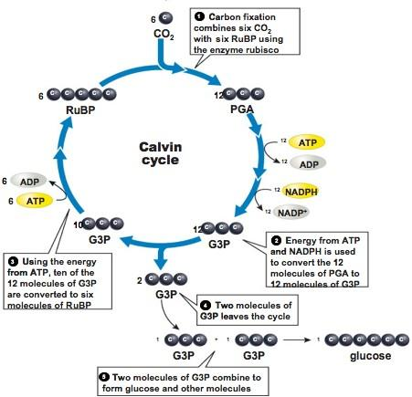
Light Independent Reactions
Also called the
Calvin cycle;
occurs in the
stroma

Slide 21
Calvin Cycle: Steps
Step 1: Carbon fixation; carbon from CO₂ bonds with a 5-C sugar called RuBP (ribulose bis-phosphate) to form an unstable 6-C sugar
Step 2: The 6-C sugar immediately splits to form two 3-C molecules
Step 3: The ATP and NADPH formed in the light dependent reactions converts the two 3-C molecules into PGAL (phosphoglyceraldehyde), a high energy sugars
Step 4: 1 out of every 6 PGALs is sent to the cytoplasm to make glucose and other carbohydrates. It takes 3 rounds of the cycle to make 6 PGAL
Step 5: RuBP is replenished as 5 molecules of PGAL make 3 molecules of RuBP; Now the cycle can continue!

Slide 22
Respiration
Cellular respiration is the process by which mitochondria break down glucose to produce ATP
All organisms carry out some form of respiration, including plants

Slide 23
Respiration
The chemical equation for respiration is:
CH₁₂O₆ + O₂ → 6H₂O +6CO₂
The reactants are glucose and oxygen.
The products are water and carbon dioxide.

Slide 24
Photosynthesis vs. Respiration
Notice that the chemical equations for photosynthesis and respiration are the reverse of each other. These processes are said to be complementary because the products of one process are the reactants of the other. The reactions that occur are not the reverse of each other, but there are some similarities.

Slide 25
Respiration
Respiration is accomplished through three stages of events;
Glycolysis; takes place I the cytoplasm
The Citric Acid Cycle; takes place in the mitochondria
The Electron Transport Chain; occurs in the space between the inner and outer membranes

Slide 26
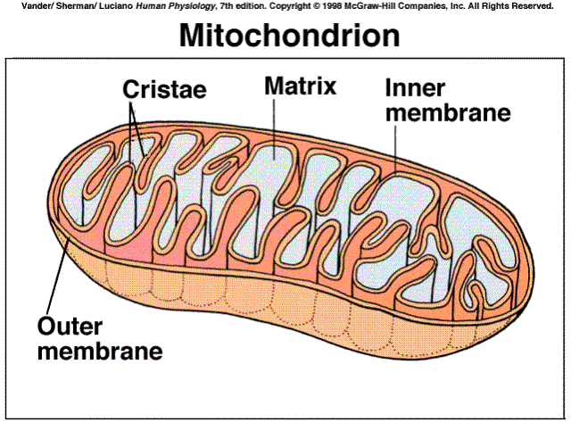
Mitochondrial Structure

Slide 27
Glycolysis
Glycolysis (“sugar splitting”) is a series of chemical reactions in the cytoplasm that break down glucose into 2 molecules of pyruvic acid, a 3-C compound. No oxygen is required for glycolysis. It is not very effective in making energy, as it produces only 2 ATP for each glucose molecule broken down.

Slide 28
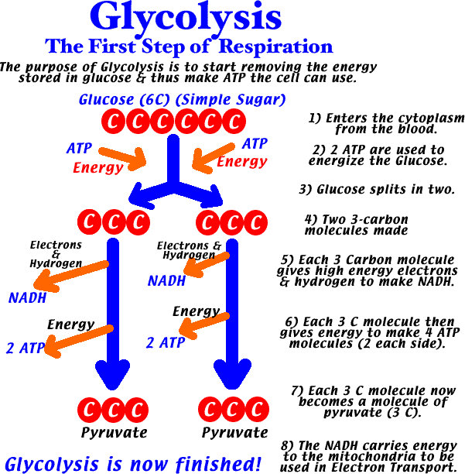

Slide 29
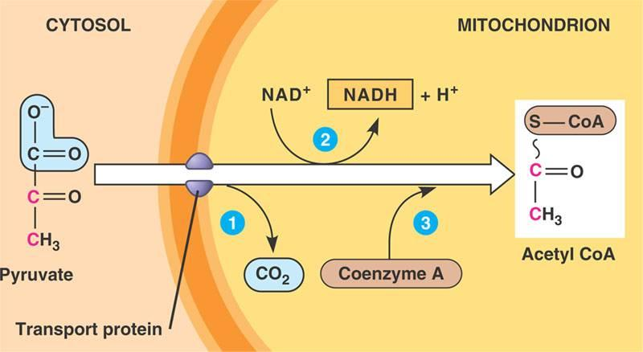
Glycolysis
Before pyruvic acid can enter the CAC, it must undergo a series of reactions in which it gives off a molecule of CO₂ and combines with a molecule called coenzyme A to form acetyl-CoA

Slide 30
Citric Acid Cycle (CAC)
The CAC is similar to the Calvin Cycle in photosynthesis in that the molecule used in the first reaction is also one of the end products. The CAC requires oxygen, so it is said to be aerobic. This cycle takes place in the mitochondria.

Slide 32
Steps of the CAC
Step 1: Acetyl-CoA (2-C) joins with oxaloacetic acid
(4-C) to form citric acid (6-C)
Step 2: CO₂ is produced, as well as a 5-C compound; NADH and H⁺ is also produced
Step 3: Another molecule of CO₂ is released forming a 4-C compound; one ATP and a molecule of NADH is also made
Step 4: The 4-C compound goes through a series of reactions in which FADH₂, NADH and H⁺ are formed; the carbon chain is rearranged and oxaloacetic acid is again made available for the cycle

Slide 33
Electron Transport Chain
In the ETC, the carrier molecules NADH and FADH₂ give electrons that pass through a series of reactions as they are passed from protein to protein. Oxygen is the final electron acceptor; it joins with H⁺ ions to form water. The ETC takes place in the space between the inner and outer mitochondrial membranes. Overall, the ETC produces 32 ATP.

Slide 34
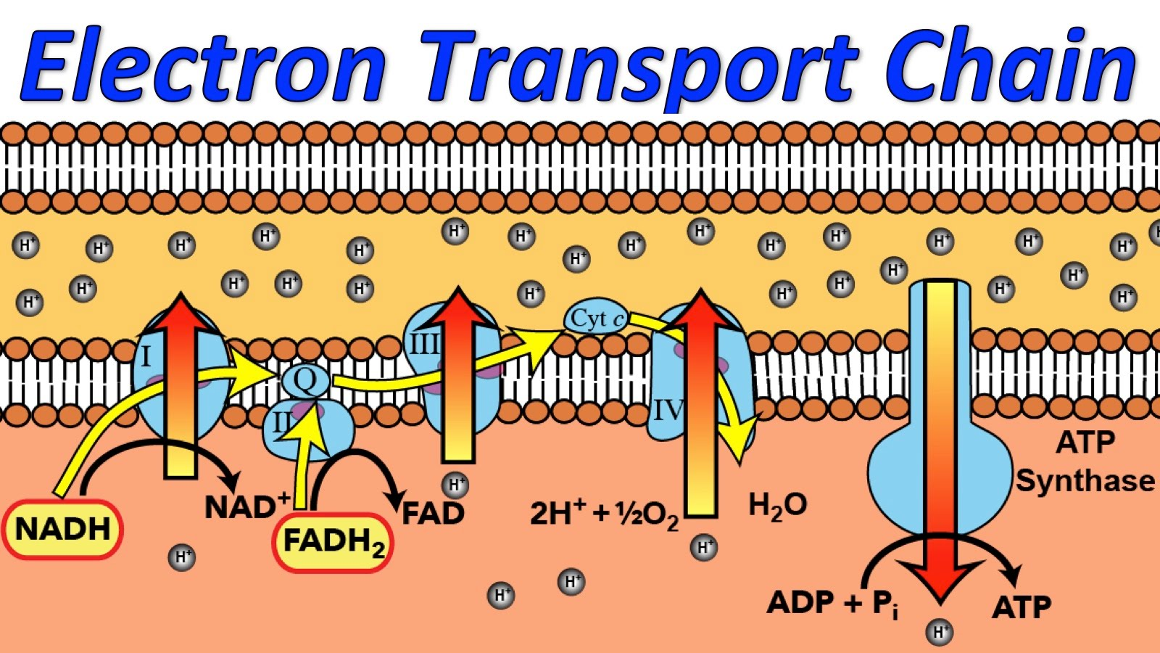

Slide 35
Energy Produced
The complete breakdown of 1 molecule of glucose requires;
Glycolysis; makes 2 ATP
The CAC; makes 2 ATP for each turn
The ETC makes 32 ATP
So, when 1 molecule of glucose is completely broken down, 36 ATP are produced

Slide 36
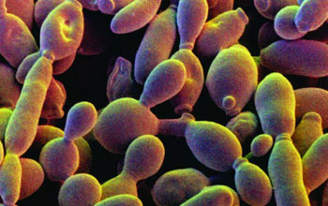
What if Oxygen is Not Present?
If oxygen is not present in overworked muscle cells or is not needed by organisms such as some bacteria and yeast, the anaerobic process of fermentation takes place.

Slide 37
Lactic Acid Fermentation
Occurs in muscle cells when they are deprived of oxygen for a short period of time during heavy exercise
This process follows glycolysis and provides a means to continue producing ATP until oxygen is available again
The reactions that produced pyruvic acid are reversed and lactic acid and 2 ATP are formed
The lactic acid is transferred from muscle cells to the liver that converts it back to pyruvic acid

Slide 38
Alcoholic Fermentation
Used by some bacteria and yeast with low energy needs
Produces CO₂ and ethyl alcohol

