Slide 1
CELL COMMUNICATION

Slide 2
Cell Communication
An organism is a community of cells
Individual cells must be able to communicate with each other
Allows coordination of activities

Slide 3
Example of Cell Communication
Hear a noise
Structures in ear convert sound waves into a nerve impulse
Nerve cells transmit impulse from one cell to another
Nerve impulse reaches brain
Brain sends a message to the adrenal gland to release hormone adrenalin
This hormone travels through blood and causes heart to beat faster
As heart beats faster, more oxygen is sent to muscles as you prepare to react

Slide 4
Chemical Signaling
Most cell-to-cell communication involves some kind of chemical signaling
Chemicals may be allowed to freely diffuse between cells
Chemicals may be received by a cell only given direct cell-to-cell contact
Chemicals may freely diffuse from one cell’s cytoplasm to another’s through structures called gap junctions which directly link the cytoplasm of adjacent cells
Cells have receptor proteins embedded in their membranes

Slide 5
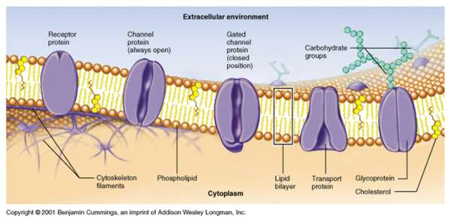

Slide 6
Receptor Proteins
Extend across lipid bilayer (cell membrane) of cells
Part of the protein on the outside of the cell has a unique shape that allows it to bind only to certain special molecules (same way a key fits a lock)
Types:
“key” in nerve cell - NEUROTRANSMITTER
"key" in other types of cells - HORMONE
Molecule (“key”) binds to the protein
Protein changes shape
Activates a signal inside cell
Causes a response

Slide 7
Types of Cell Communication
Hormone
Nerve Signaling

Slide 8
Hormonal Communication: Hormones
Body’s chemical messengers
Transfer information and instructions from one set of cells to another
Many different hormones circulating through bloodstream
Each hormone has different effect on body
Can only affect cells with receptors that recognize the hormone and alter cell function

Slide 9
Function of Hormones
Affect mood
Influence growth and development
Regulate metabolic processes
Help tissues function

Slide 10
Hormone Levels
Influenced by changes inside and outside our body
Stress
Infection
Changes in balance of fluid and minerals in blood

Slide 11
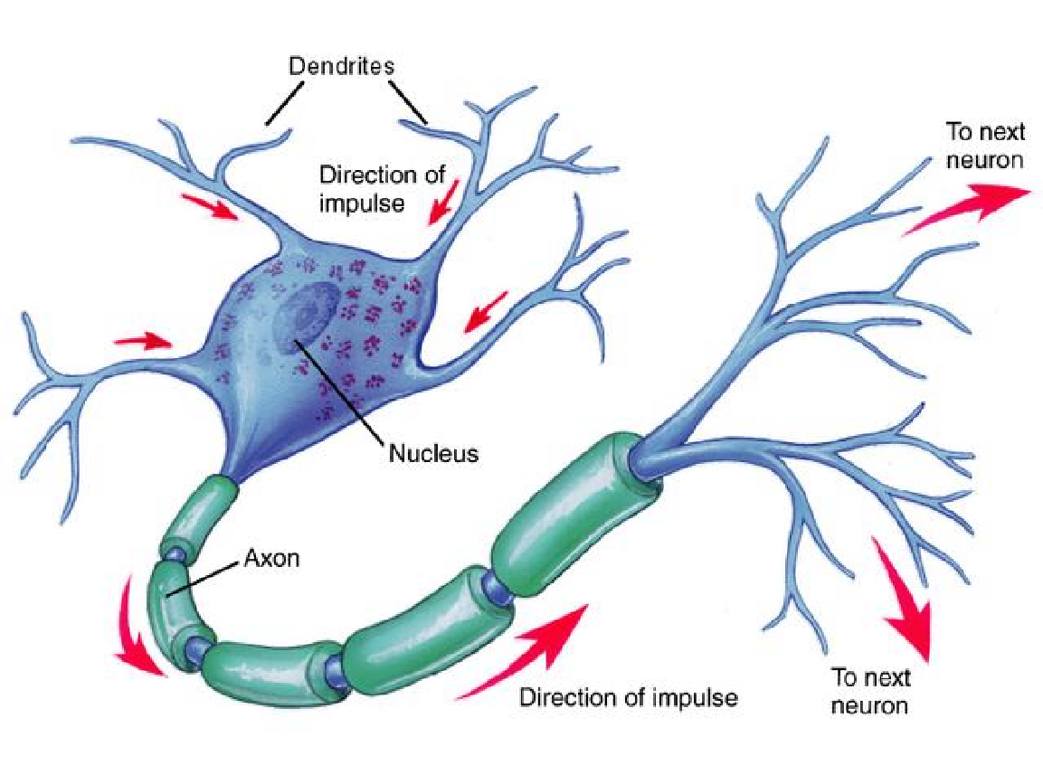
Neural Communication: Nerve Signals
Use cells called neurons

Slide 12
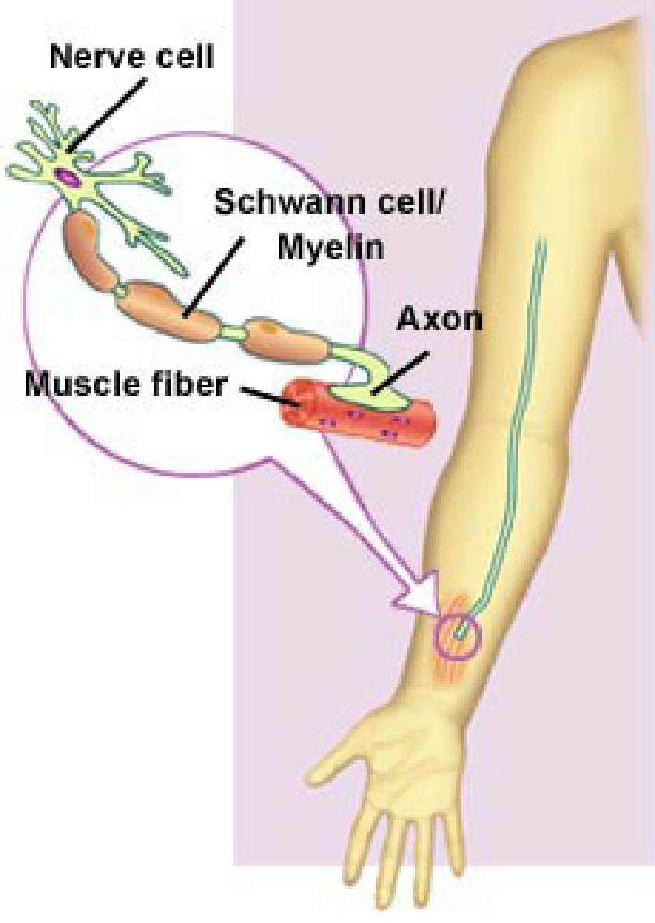
Example of Neural Communication

Slide 13
How Nerve Signal is Transmitted
Incoming messages are received by dendrites of nerve cells
Chemical messages pass into the cell body and then through the axon
Signal heads out to connected neurons in the form of chemicals called neurotransmitters
These flow from a message-sending neuron across a gap called a synapse and onto target neurons
Chemicals attach to a receptor protein
Different neurotransmitters either trigger "go" signals that allow the message to be passed to the next neuron in the communication line or produce "stop" signals that prevent the message from being forwarded
Signals are in the form of charged particles or ions
Positively-charged particles entering a receiving neuron signal “Go”
Negatively-charged particles entering the neuron signal “Stop”

Slide 14
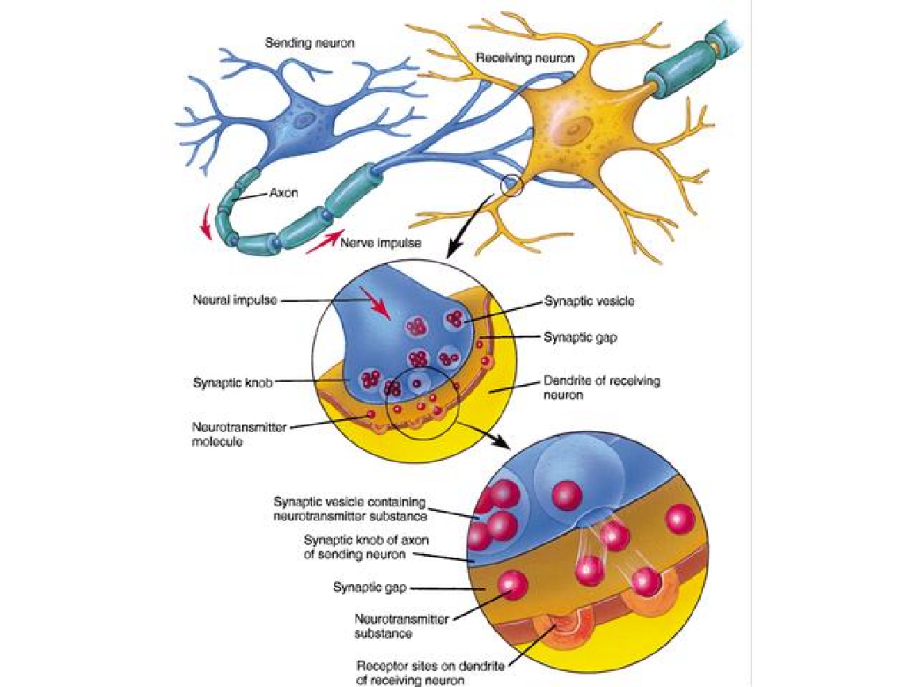

Slide 15
Comparing Hormonal to Neural Communication
Hormones
Nerve Signals
Act slowly
Produced in small amounts
Release of hormones into bloodstream
Rapid messages
Release of neurotransmitters into synapse

