Slide 1
Chemistry of the Cell

Slide 2
Key Elements
Element – type of matter composed of only one kind of atom which cannot be broken down to a simpler structure
6 Common Elements in Living Things
Sulfur
Phosphorous
Oxygen
Nitrogen
Carbon
Hydrogen

Slide 3
Organic Molecules
Molecules containing carbon
In all living things

Slide 4
Compounds Containing Carbon
Carbon is essential to life
Carbon atom can form millions of different combinations with other atoms because of its bonding versatility
18% of a person’s weight comes from carbon atoms
50% of a tree’s weight comes from carbon atoms

Slide 5
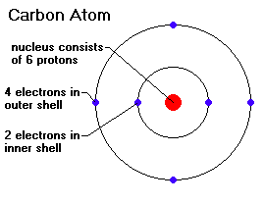
Carbon Compound Characteristics
Carbon atom has 6 electrons
Carbon wants 4 more electrons
Can form covalent bonds with up to 4 atoms

Slide 6
Inorganic Molecules
Molecules that do not contain carbon
Water most important inorganic molecule for living things
Medium where cellular reactions take place

Slide 7
Biomolecules
Carbohydrates
Lipids
Proteins
Nucleic acids

Slide 8
Carbohydrates
Sugars
Importance
Energy source
Elements
Carbon - 1
Hydrogen - 2
Oxygen - 1
Structure
Chains of carbon units
Hydroxyl groups (-OH) attached

Slide 9
Monosaccharide
Simple sugars
Glucose
universal cellular fuel broken down by virtually all living things with the release of energy stored in bonds
Fructose
fruit sugar because it is the compound that gives many kinds of fruit their sweet taste
Galactose
common subunit of other sugars, such as milk sugar
C₆H₁₂O₆
Different arrangements of the same atoms

Slide 10
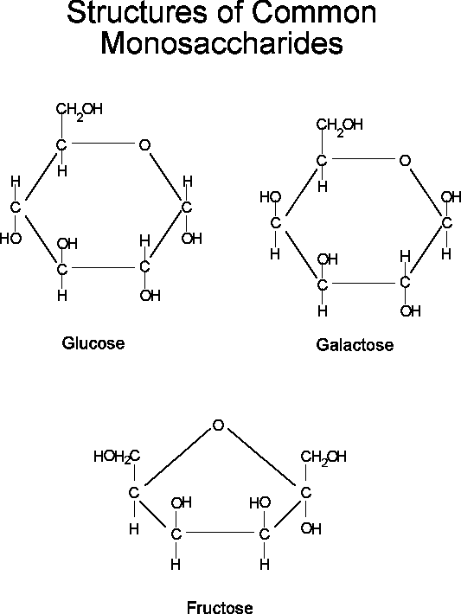

Slide 11
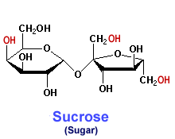
Dissacharides
Two unit molecules
Combinations of two simple sugars
Sucrose
fructose + glucose
Lactose
galactose + glucose
Maltose
glucose + glucose

Slide 12
Oligosaccharides
3-10 monosaccharides joined together
Sugars being assembled or broken down

Slide 13
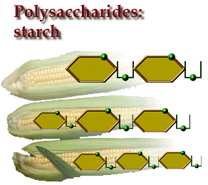
Polysaccharides
Complex Sugars
1 0+ monosaccharides joined together
Starch & Glycogen - primary energy reserves of plants and animals
Cellulose & Chitin - structural polysaccharides

Slide 14
Cellulose & Starch
Differ in bonding patterns between monomers
Cellulose - tough, indigestible, structural material in plants
Starch - easily digested, storage form in plants

Slide 15
Glycogen
Sugar storage form in animals
Large stores in muscle and liver cells
When blood sugar decreases, liver cells degrade glycogen, release glucose

Slide 16
Chitin
Polysaccharide
Nitrogen-containing groups attached to glucose monomers
Structural material for hard parts of invertebrates, cell walls of many fungi

Slide 17
Function of Carbohydrates
Provide the body with heat and energy
Fiber helps the movement of food through the intestine
Fiber rich and starchy foods provide a "full feeling"

Slide 18
Empty Kilocalories
Some foods contain only sugars
Do not contain any other nutrients
Provide empty kilocalories
Too much sugar in the diet causes tooth decay

