Slide 1
Asexual vs. Sexual Reproduction

Slide 2
Asexual Reproduction
By _________________________
Some unicellular organisms
Amoeba
Bacteria
Many _________________
Offspring produced genetically ________________________ to parent

Slide 3
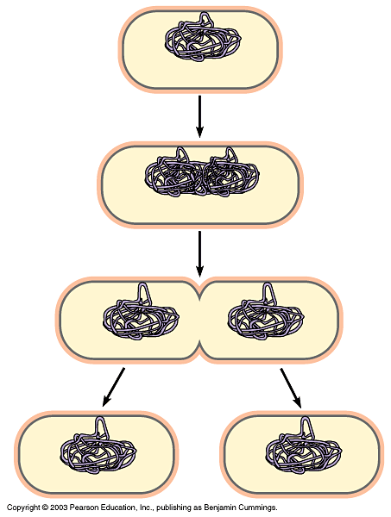
Binary ________
Prokaryotic chromosome
Plasma membrane
Cell wall
Duplication of chromosome and separation of copies
Continued growth of the cell and movement of copies
Division into two cells

Slide 4
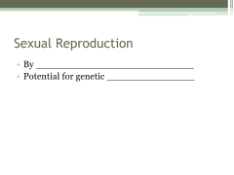
Sexual Reproduction
By ___________________________
Potential for genetic _______________

Slide 5
Genetic Variation
Number of possible chromosome combinations in gametes is 2^{n}
n – __________________ number
2 – number of ______________________ in a homologous pair
n= 2
_____________ possible distributions
n=3
_____________ possible distributions
n=23
________________________possible distributions before fertilization

Slide 6
Fertilization
________ fuse to form new diploid parent cell
_______________________
Each parent contributes one homolog to each homologous pair of chromosomes
Mitosis
____________________________ in size
Becomes an ________________________

Slide 7
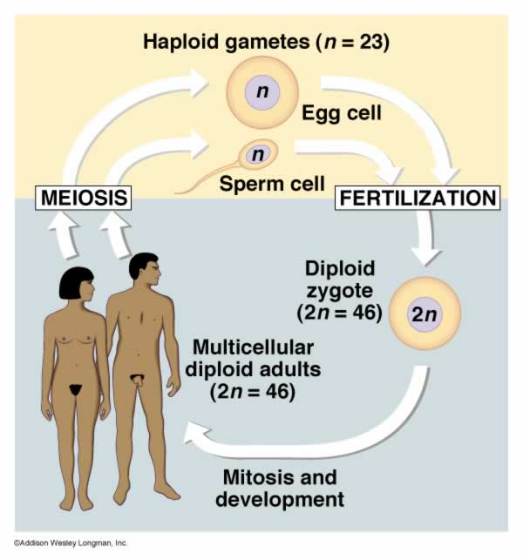

Slide 8
Stem Cells (embryonic or pluripotent)
Group of cells produced in _________ ____________of the embryo’s growth
Similar to ____________________ zygote
Have the capability of becoming ____ ______ of cell
Genes within the cell can be ________ _____ or turned on at specific time

Slide 9
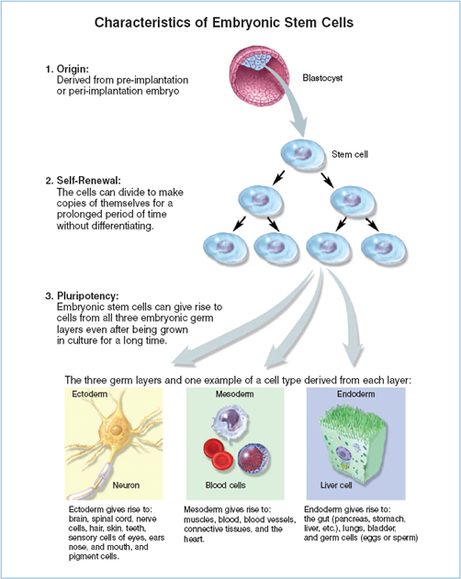

Slide 10
________________ STEM CELLS
-undifferentiated cells found among differentiated cells in a ___________ ____ ________________that can renew itself and can differentiate to become some or all of the major cell types of that tissue or organ
-primary role is to _______________ and _________________ the tissue where it is found

Slide 11
Cell ________________________
Occurs by selective activation or inactivation of some of the genes
Cells become _____________________
Later become ____________________
Occurs when embryo reaches ~20-150 cells in size
Proteins are produced characteristic to its specific function

Slide 12
