Slide 1
Meiosis

Slide 2
Meiosis
Cell division for sexual _______________
Limited to reproductive cells
____________
____________
Produces _____ haploid reproductive cells
Gametes
Male – ______________
Female – _________
Not identical to mother cell

Slide 3
Interphase
Each ________ of chromosomes replicates
Cell _____________________
Cell replicates _________________ and makes more _____________________

Slide 4
Meiosis I
Each set of replicated chromosomes _____ _____ with its homologous pair in Prophase I forming a four chromosome structure called a ________________

Slide 5
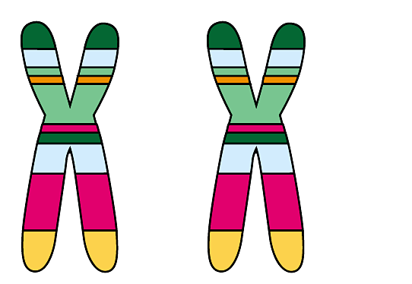
Homologous Chromosomes
Matched pairs of _______________Similar in size and shape
Carry same kinds of _____________
Not ____________
Each set comes from a different _____________
Chromosomes
Centromere
Sister chromatids

Slide 6
Crossing Over
During _____________________, homologous chromosomes break apart and exchange segments
This is a huge source of genetic ______________________

Slide 7
Coat-color genes
Eye-color genes
How crossing over leads to genetic _____________
Tetrad (homologous pair of chromosomes in synapsis)
1
Breakage of homologous chromatids
2
Joining of homologous chromatids
Chiasma
3
Separation of homologous chromosomes at anaphase I
4
Separation of chromatids at anaphase II and completion of meiosis
Parental type of chromosome
Recombinant chromosome
Recombinant chromosome
Parental type of chromosome
Gametes of four genetic types

Slide 8
Random Alignment
Random _______________ of chromosomes also creates genetic variation
Occurs during _________________, as _________________ line up on the equator of the cell

Slide 9
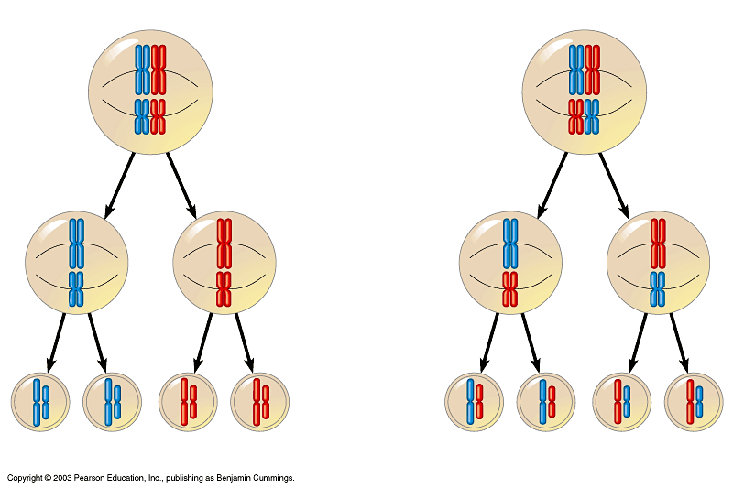
POSSIBILITY 1
POSSIBILITY 2
Two equally probable arrangements of chromosomes at metaphase I
Metaphase II
Gametes
Combination 1
Combination 2
Combination 3
Combination 4

Slide 10
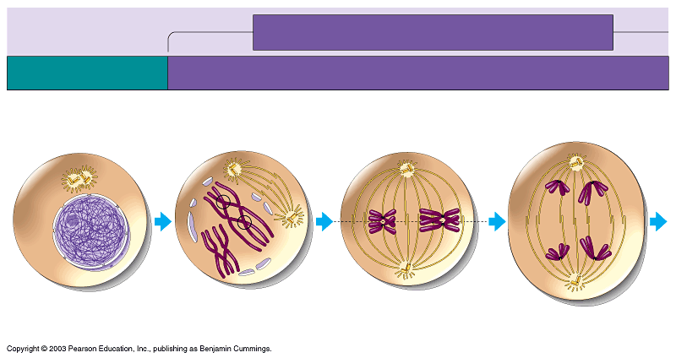
MEIOSIS I: Homologous chromosomes separate
INTERPHASE
PROPHASE I
METAPHASE I
ANAPHASE I
Centrosomes (with centriole pairs)
Sites of crossing over
Microtubules attached to kinetochore
Metaphase plate
Sister chromatids remain attached
Spindle
Nuclear envelope
Chromatin
Sister chromatids
Tetrad
Centromere (with kinetochore)
Homologous chromosomes separate

Slide 11
Product of Meiosis I
2 ________________ cells
Each contains ____________________of each of the homologous pairs

Slide 12
Interkinesis
________________________before meiosis II begins

Slide 13
Meiosis II
2 daughter cells _________________
No replication of chromosomes since we are trying to _____________chromosome number

Slide 14
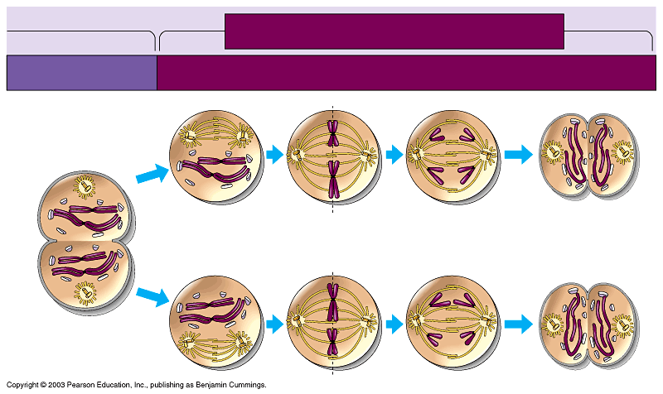
MEIOSIS II: Sister chromatids separate
TELOPHASE I AND CYTOKINESIS
PROPHASE II
METAPHASE II
ANAPHASE II
TELOPHASE II AND CYTOKINESIS
Cleavage furrow
Sister chromatids separate
Haploid daughter cells forming

Slide 15
Product of Meiosis II
4 ______________________ daughter cells that are __________________
When _______________________ of the egg occurs, the ______________ number of chromosomes is restored

Slide 16
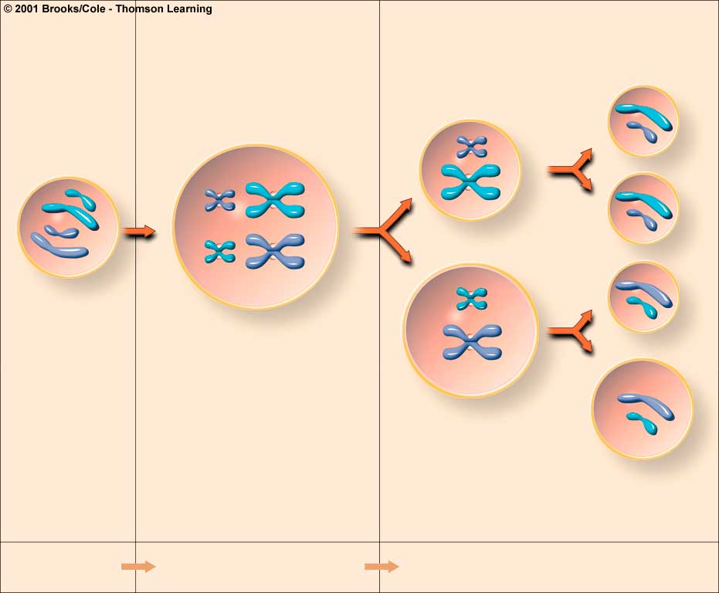
Oogenesis
three polar bodies haploid)
first polar body haploid)
oogonium (diploid reproductive cell)
primary oocyte (diploid)
secondary oocyte haploid)
ovum (haploid)
Growth
Mitosis I,
Cytoplasmic division
Meiosis II,
Cytoplasmic division

Slide 17
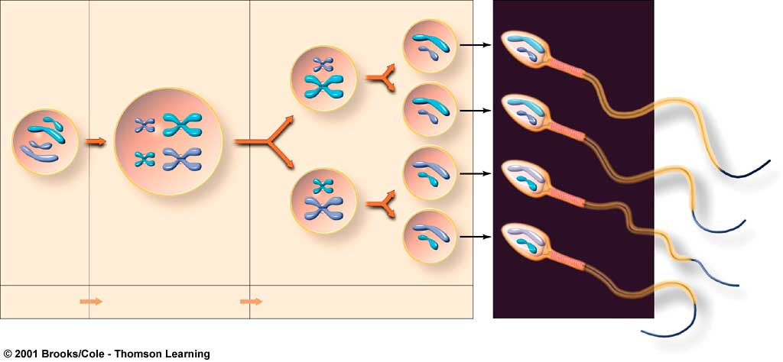
Spermatogenesis
secondary spermatocytes (haploid)
spermato-
gonium (diploid male reproductive cell)
primary spermatocyte (diploid)
spermatids (haploid)
Growth
Mitosis I,
Cytoplasmic division
Meiosis II,
Cytoplasmic division

Slide 18
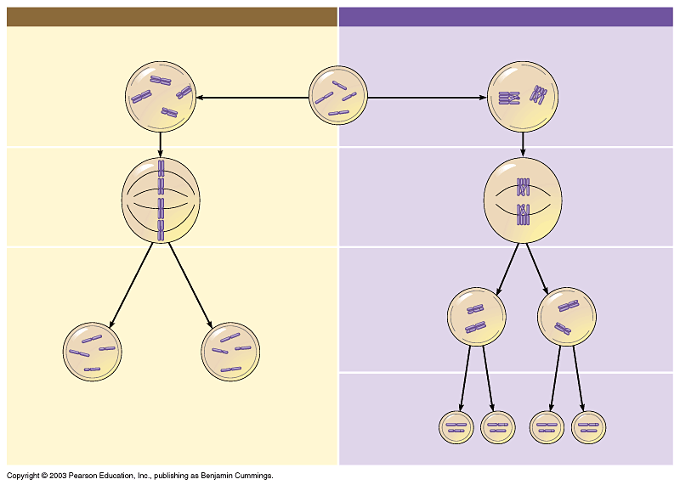
MITOSIS
MEIOSIS
PARENT CELL (before chromosome replication)
Site of crossing over
MEIOSIS I
PROPHASE
PROPHASE I
Tetrad formed by synapsis of
homologous chromosomes
Duplicated chromosome (two sister chromatids)
Chromosome replication
Chromosome replication
2n = 4
Chromosomes align at the metaphase plate
Tetrads align at the metaphase plate
METAPHASE I
METAPHASE
ANAPHASE TELOPHASE
Sister chromatids separate during anaphase
Homologous chromosomes separate during anaphase I; sister chromatids remain together
ANAPHASE I
TELOPHASE I
Haploid n = 2
Daughter cells of meiosis I
2n
2n
No further chromosomal replication; sister chromatids separate during anaphase II
MEIOSIS II
Daughter cells of mitosis
n
n
n
n
Daughter cells of meiosis II

