Slide 1
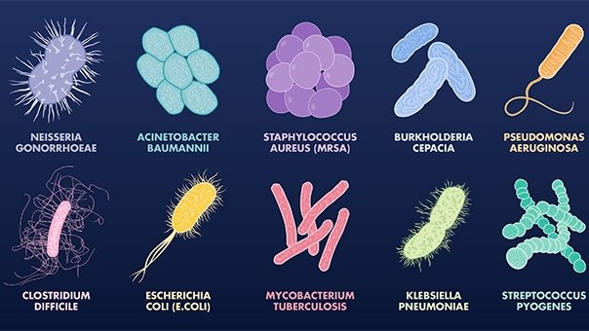
Bacteria

Slide 2
Two kingdoms of bacteria:
___________________________: most common
_______________________ – oldest organisms on
earth, inhabit extreme conditions
Methanogens, halophiles, thermoacidophiles

Slide 3
Bacteria are:
___________________________
___________________________; have no true nucleus or
other membrane bound organelles
Some are autotrophic, some are heterotrophic
Some are ______________________________; require oxygen
Some are obligate anaerobes; ___________________________
___________________________________________________

Slide 4
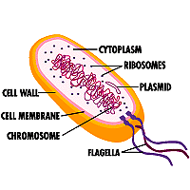
Bacteria contain:
______________________ (nucleoid)
circular pieces of DNA called _________________
DO have _______________

Slide 5
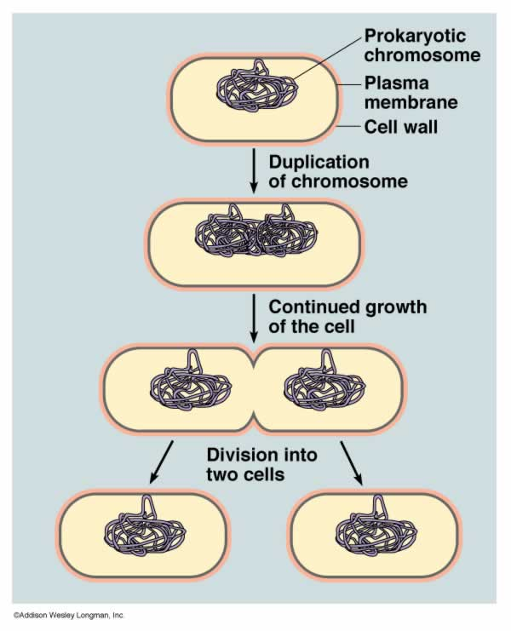
Bacteria
reproduce:
Asexually using _______________________________.

Slide 6
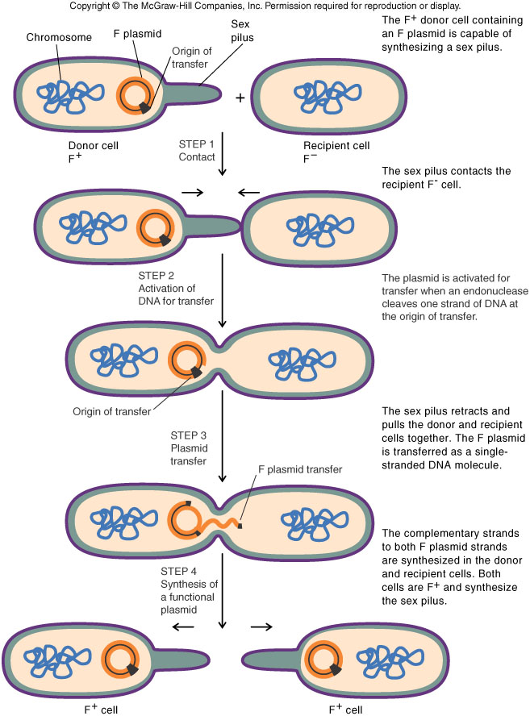
Bacteria reproduce:
___________________________________.
Bacteria exchange ____________________.
This is how bacteria become _______________________
____________________.

Slide 7
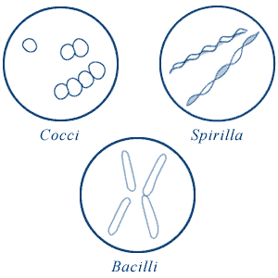
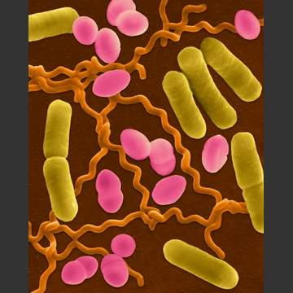
Three bacterial shapes:
____________ shaped; bacillus(i)
____________ shaped; coccus(i)
____________ shaped; spirillum(i)

Slide 8
Antibiotics:
Work by __________________________________
__________________________________________
__________________________________________.
Common Bacterial Infections
______________________; rash, fever, fatigue, head/muscle pain
____________________; muscle spasm, paralysis/death
______________________; fever, sore throat, swollen glands

